Slide 1

IT as an Agent of Change in Employability
Chris Cardew 1st April 2015
Notes:
How can the potential of information technology be fully harnessed? How can IT be used not just as tool or alternative, but as an agent of change?
From the individual to the economy globally

Slide 2
Information Technology
How has IT caused change so far?
What/Who are the drivers of the change
  How does IT integrate with your economy
  Does IT fit with your identity
Which elements can embrace employability
  Making use of our networks to keep abreast of changes
Notes:
Why take a broad outlook?
The reason is because how we behave as individuals is influenced by what is around us particularly with relation to technology.
We are also influenced by the powers that run our regions, countries and ultimately on a global basis.
Education and the curriculum with also influence how young people behave and decide on what to study and what they want to do when they start work.
In this sense Identity is important not only at individual level but at all levels.

Slide 3

A reminder of the rapid progress of Information technology

Slide 4
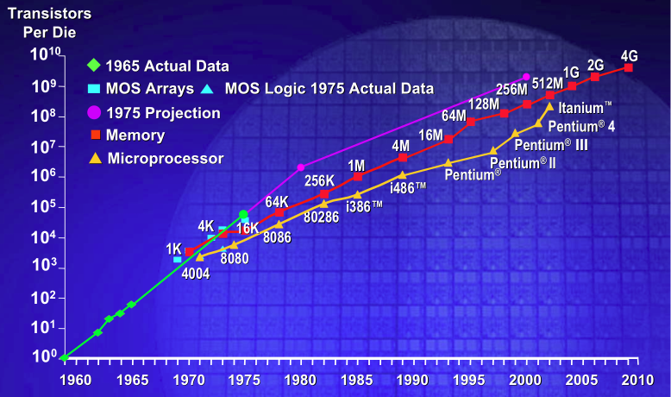
Moore’s Law – the number of transistors per square inch on an IC had doubled every year since the IC was invented (1965)
This observation by Moore in 1965 continues year on year
Notes:
The hardware continues to support advances in IT

Slide 5
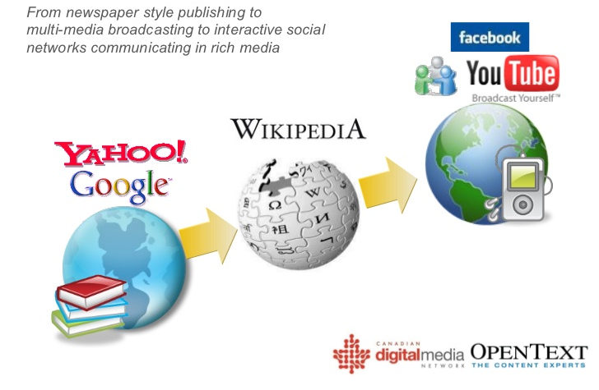
Digital media transmission techniques, high speed cabling, WiFi developed for commerce have benefitted everyone.
Notes:
It is no good just having the hardware the software technology must grow too
Digital media transmission has been instrumental in the growth of IT
Making high speed communication with media rich content available on mobile devices

Slide 6
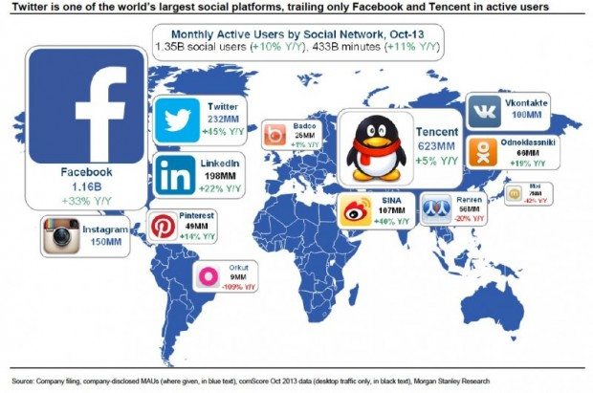
Anyone can create a profile rich in media, easily publish anything on the web and share it
Notes:
Social networks are one of the biggest ways in which IT can support employability.
Most of these are for fun.
Several though are used for employability and one for employability as its main driver

Slide 7
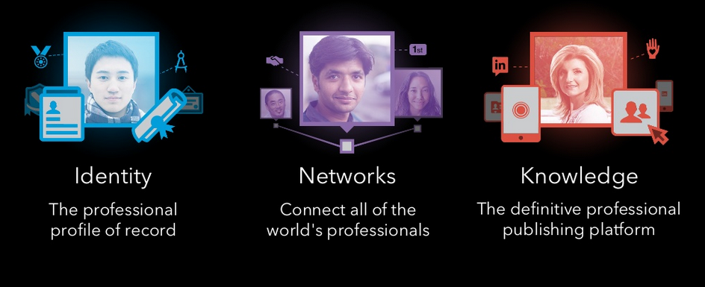
Using Social Networking successfully
Who you are
Who you know
What you know
Notes:
As the technology shows no sign of slowing down then we can do more and more.
Focussing on a student and a graduate then online profiles can become more sophisticated with rich media content being the norm.
Identity – professional profile of record
Networks - connect
Knowledge – insights and relevant content

Slide 8
How have economies embraced IT?

Slide 9
A shift to embrace IT
Where the jobs are - UK:
  Knowledge intensive services now account for 34% of UK output and 29% of total employment.
  77% of UK GVA is accounted for by the services sector
  Services also dominate UK employment, accounting for 83% of jobs
  Manufacturing (8%) and construction (6%) are the next two largest sectors by employment
Notes:
Where are the jobs locally and globally.
What is the economic identity of your area/country and how does it fit with the region and globally.
Using IT as an agent of change at country level.
The Service Industry:
An industry made up of companies that primarily earn revenue through providing intangible products and services.
Service industry companies are involved in retail, transport, distribution, food services, as well as other service-dominated businesses. Also called service sector, tertiary sector of industry. See also primary industry, secondary industry.
Read more: http://www.businessdictionary.com/definition/service-industry.html#ixzz3UAdzgsOt

Slide 10
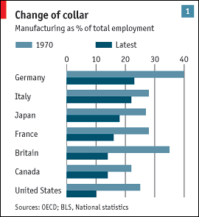
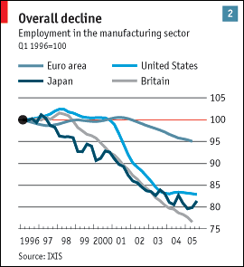
Shift from Manufacturing to Service Industry at a glance
By accident or by design?
Notes:
Graphically this shows how various countries have taken different economic strategies.
Strategies that were made possible by using advancements in IT to drive these changes

Slide 11
MAKE OR BREAK: THE UK’S DIGITAL FUTURE – Feb 2015
The UK Forum for Computing Education (UKForCE) used this framework to analyse the 361 Standard Occupation Codes (SOCs), which cover the entire estimated 30 million people employed in the UK
Digital skill level categories
‘Digital muggle’: 2.2 million people (7% of the workforce); “… no digital skills required—digital technology may as well be magic”.
‘Digital citizen’: 10.8 million people (37% of the workforce); “… the ability to use digital technology purposefully and confidently to communicate, find information and purchase goods/services”.
‘Digital worker’: 13.6 million people (46% of the workforce); “… at the higher end, the ability to evaluate, configure and use complex digital systems. Elementary programming skills such as scripting are often required for these tasks”.
‘Digital maker’: 2.9 million people (10% of the workforce); “… skills sufficient to build digital technology (typically software development)”.
http://www.publications.parliament.uk/pa/ld201415/ldselect/lddigital/111/111.pdf p42

Slide 12
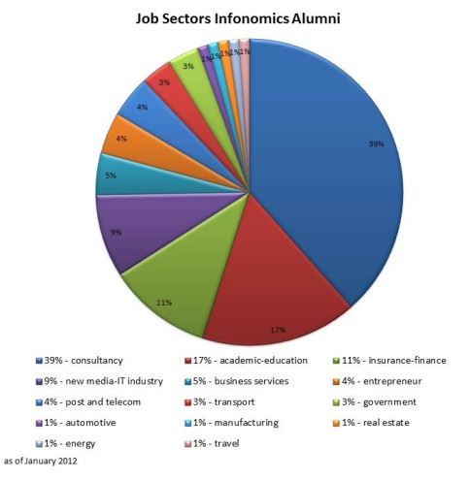
Most graduates from Business and Management work in IT related sectors
Notes:
What do Business and Management students do?
Almost exclusively related to IT in some way

Slide 13

No longer possible to recognise what people do by their uniform/clothes
Notes:
No longer possible to recognise what people do by their uniform/clothes

Slide 14
It for the entrepreneur

Slide 15
IT and Entrepreneurship
Those with an aptitude towards TECHNOLOGY DEVELOPMENT and a vision (a few)
  Microsoft, Facebook, Twitter, etc.
Those with a vision but SOME APTITUDE TOWARDS technology development (a few)
  Apple (Wozniak was the technologist, Jobs had the vision)
Those with a vision and an aptitude in USING technology (many)
  New applications mean that entrepreneurs no longer need to be programmers (e.g. Wix, WordPress, Joomla etc.)
Crowd funding
  Support for start-ups with ideas that excite those with wealth – the ability for anyone to be able to publish on the internet has made this possible (e.g. Kickstarter)
Notes:
It and Entrepreneurship has shifted from those with an aptitude towards developing technology coupled with a vision.
Often we saw partnerships in tech start-ups that included technical and visionary partners.
Now we have applications that allow anyone with a vision to start-up.
We can support our students by offering courses with entrepreneurship built in.
Also providing online support for self employment e.g. Abintegro

Slide 16
It in education

Slide 17
The End of University as we know it?
In the American Interest online – Nathan Harden
  In fifty years, if not much sooner, half of the roughly 4,500 colleges and universities now operating in the United States will have ceased to exist.
  Access to college-level education will be free for everyone;
  -the residential college campus will become largely obsolete
  -tens of thousands of professors will lose their jobs
  -the bachelor’s degree will become increasingly irrelevant
  -ten years from now Harvard will enrol ten million students.
  MOOCs massive open online courses
  Recent history shows us that the internet is a great destroyer of any traditional business that relies on the sale of information.
Notes:
http://www.the-american-interest.com/2012/12/11/the-end-of-the-university-as-we-know-it/
Online and Self Learning:
The evidence showed there is already an increased emphasis on self-learning and online learning, such as through MOOCs, to support CPD.
This re-emphasis needs to apply across the existing workforce, throughout the education system, and to those returning to work to enable the population to adapt to their changing work environments.
The first Government supported MOOC to educate cybersecurity professionals launched in September 2014; and Codecademy—a free online programming website— had 24 million learners from around the world as of January 2015.
Self-learning has no guarantee of success; risks include whether learners and educators know where to look for courses and reliance on a learner’s motivation. Professor Martin Weller from the Open University told us: “The completion rates on these MOOCs, the big open courses, are very low at around 10%.”
Evidence suggested that a solution lies in incorporating ‘learning to learn’ within the education system.
For instance, the Chartered Institute of Library and Information Professionals told us: “The only way you can prepare students for a future workplace of such volatility is by inspiring them to become confident independent learners.” We agree.

Slide 18
Online and Self Learning
Continued increase in self learning via MOOCs
Codecademy – a free online programming website had 24 million learners as of Jan 2015
BUT…The completion rates of MOOCs is very low at present at around 10%
Evidence suggests that a solution lies in incorporating ‘learning the learn’ within the education system…the main skill of the HE graduate no less.
http://www.publications.parliament.uk/pa/ld201415/ldselect/lddigital/111/111.pdf

Slide 19
What is happening now that can change employability

Slide 20
The Critical Mass of LinkedIn
Student reviews at Swansea University (January 2015):
  Other universities offer tutorials and classes on how to use it (LinkedIn) effectively – fits with ‘ambition’ and ‘keeping in touch’ with the network created at university
  Clearly communicate the advantages and disadvantages of using this network to show the difference to Facebook and establish the ‘purpose’ of using LinkedIn
Notes:
Ask the students and they will help.
If I were to choose one tool that I think will change the way students and graduates get jobs then it is LinkedIn
It would be easy to discuss in general philosophical terms, but having an opinion, making a prediction can create further discussion, help to create strategy even if it turns out to be wrong in the long run.

Slide 21



332,000,000+ members
The World’s Largest Professional Network
Sweden
1M+
UK
17M+
NL
5M+
DACH
France
5M+
Russia
8M+
Canada
3M+
Italy
Turkey
9M+
EMEA
Spain
7M+
3M+
USA
98M+
China
6M+
100M+
U.A.E
5M+
Mexico
1M+
6M+
India
27M+
Brazil
Australia
18M+
South Africa
6M+
3M+
Notes:
332 Million profiles, 1.9 Million jobs, 3.4 million companies, 40 million students and recent graduates

Slide 22
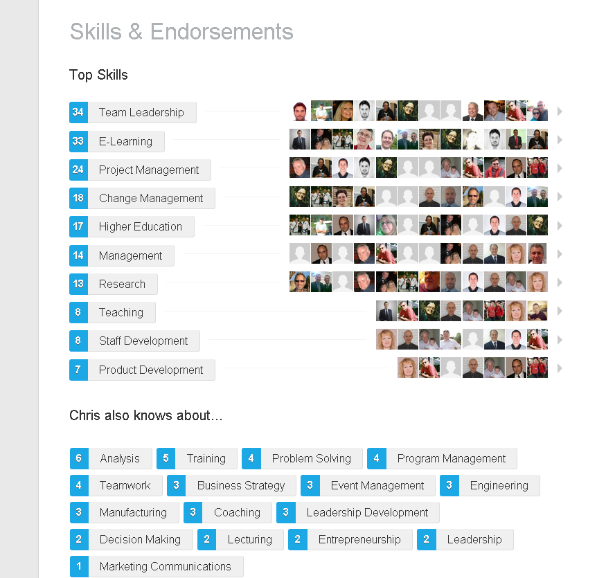
Unlike a CV these Skills and Endorsements are MADE BY THE PEOPLE IN MY NETWORK.
These are the skills that the people that I work with think I have.

Slide 23
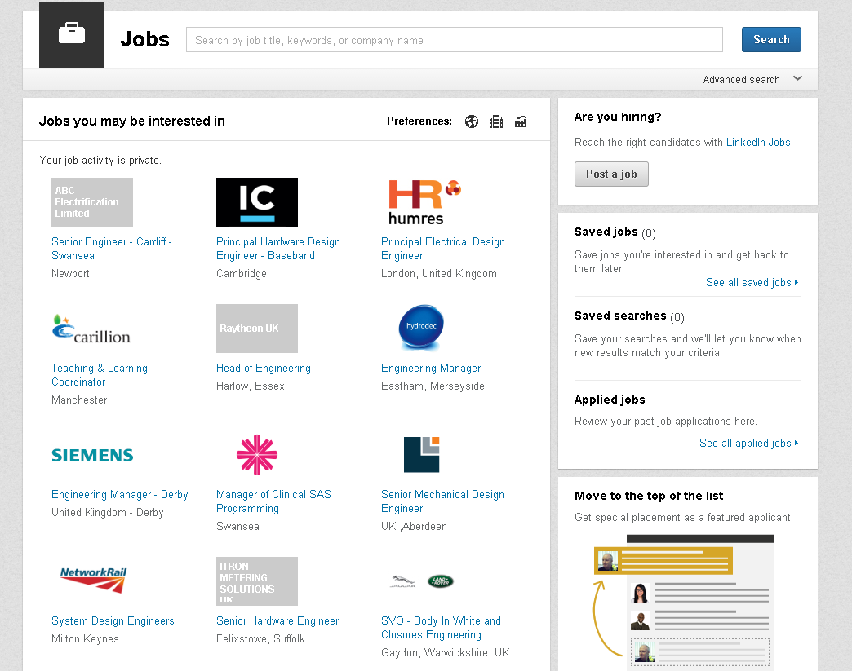
My profile and skills determine the jobs that might be of interest to me

Slide 24
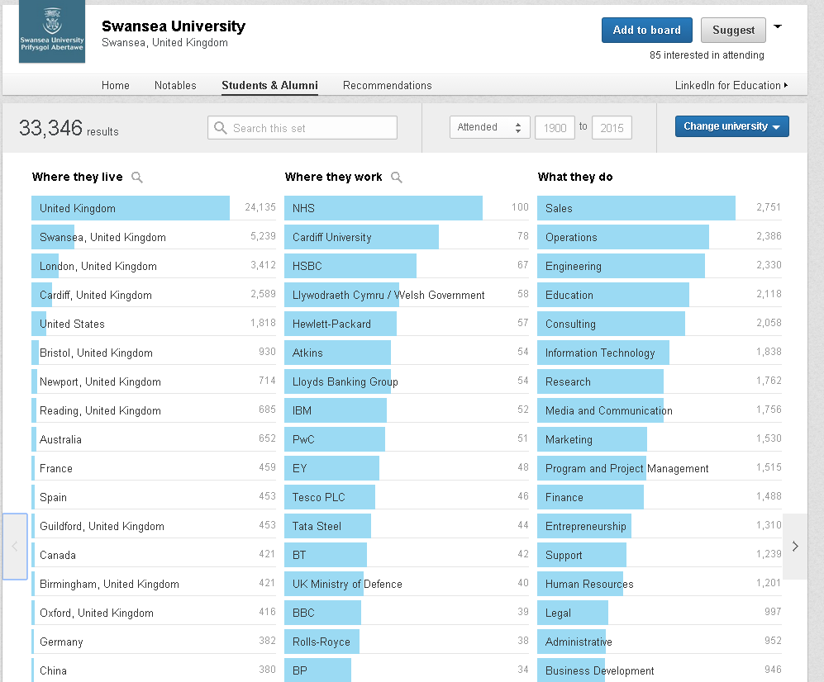
https://www.linkedin.com/edu/
Notes:
What is the Swansea University Identity
Where do alumni work?
What are they doing?

Slide 25
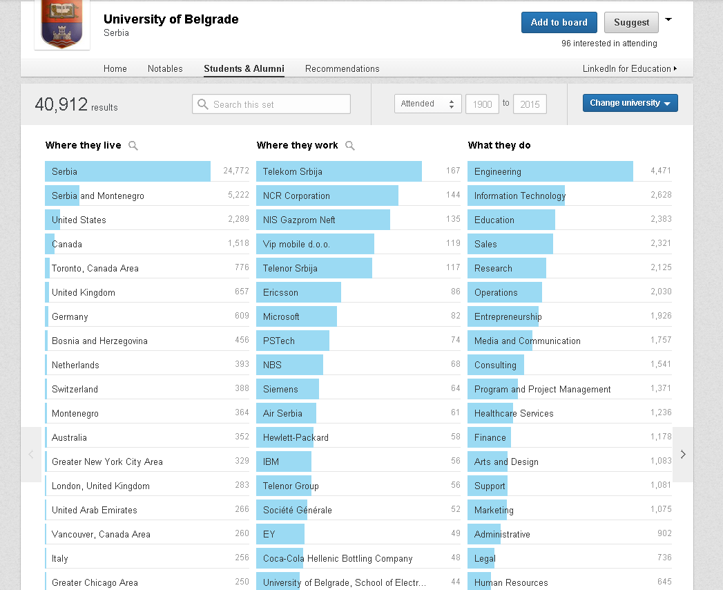
https://www.linkedin.com/edu/
Notes:
This gives me a good idea of the identity of Belgrade University, where graduates go to work and what they do.
How can I use this data to help me as
A school student choosing a university
A final year student deciding where to apply for work
Careers staff to gain an idea of what graduates are doing

Slide 26
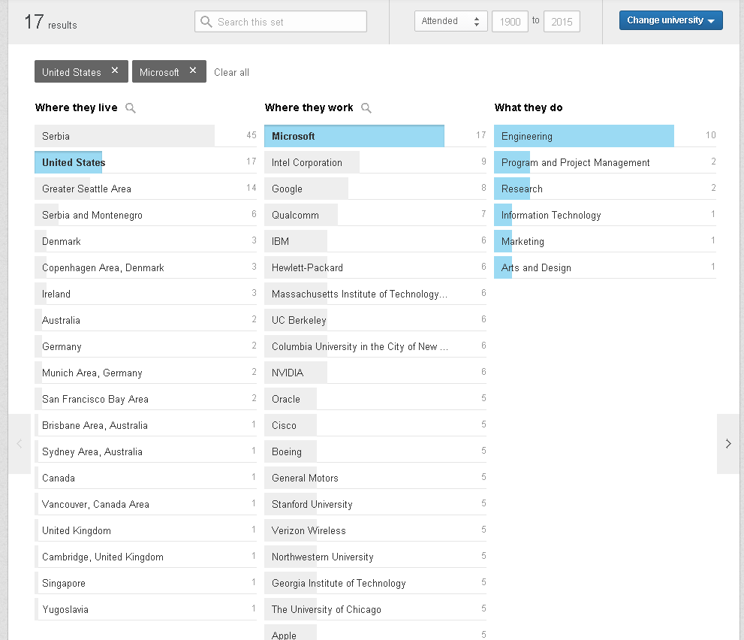
How many graduates of Belgrade University work for Microsoft in the US?
And what do they do there?
Notes:
How may of our alumni work for Microsoft in the US?

Slide 27
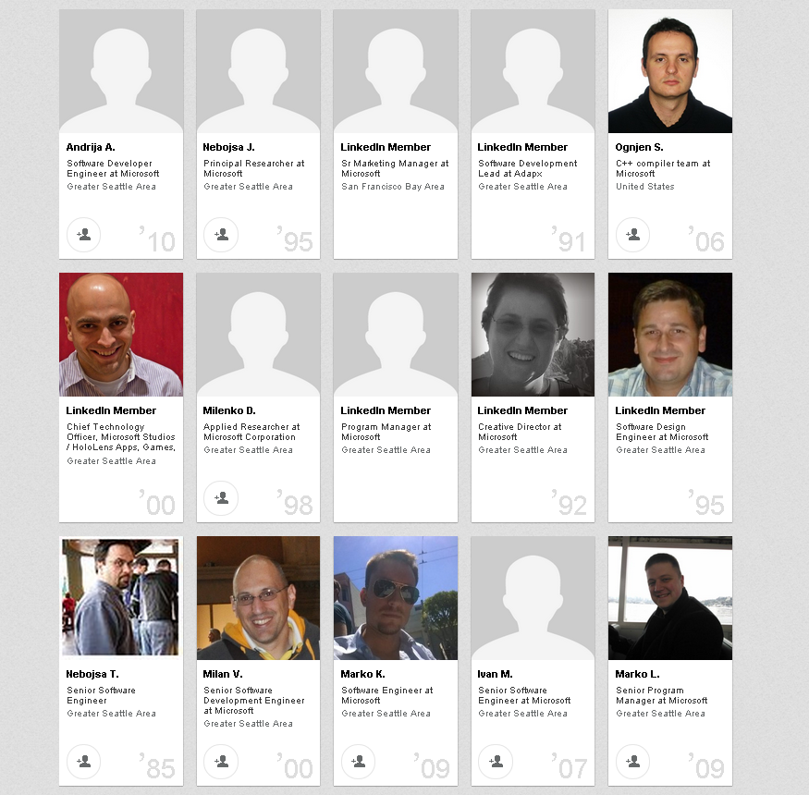
Who are the Belgrade University graduates working for Microsoft in the US
THIS DATA IS OPEN TO ANYONE
How can I use it to enhance employability:
Student
Staff
Employer
Notes:
Who are they?
Can I contact them?

Slide 28
What can we do?

Slide 29
Where to next
Create YOUR strategy for YOUR students.
  – keep it simple
Using Online tools for individuals to help themselves:
  Identity and self awareness
    Values and motivation (Team Focus; Profiling for Success)
    CV and LinkedIn profile
  Decision making
    How do we make decisions about our Career
  Guidance 1-1, group and online
    Careers professionals – embedded into curriculum
  Labour market information
    Prospects planner, ONS
  Knowing where to find information
    Careers website, Abintegro, 10MinsWith
  Applying for jobs
    Keeping abreast of the ways that employers and graduates network
Notes:
Review regularly, change as appropriate, consult stakeholders

