Slide 1

The Future Career Service:
quality management and funding opportunities
Gilda Rota

Slide 2

OUR WORLD HAS CHANGED
The “dejobbing” wrought by the global economy has produced the “insicure worker”, including employees who are called temporary contingent, casual contract, freelance part time, external, atypical, consultant and self –employed
The transformation of the labour force from core workers with permanent
Jobs to peripheral workers with temporary assignments has already affected nearly half of workers in Europe
.

Slide 3
CAREER SERVICE DEVELOPMENT
THE STUDENTS OF 2020
To serve the students of 2020
Universities need to be thinking about what value they are adding to a student’s learning
.

Slide 4
CAREER SERVICE DEVELOPMENT
How does effectively my office currently serve the students’needs ?
What do we need to do to adapt our career offices to the new requirements?
Does exist a model of a future career service?

Slide 5
FUTURE CAREER SERVICE
Main Topics
Mission Statement and quality management: What is the purpose of Career Service today, what is their aim?
What kind of services do our students really need?
How effectively does our offices serve all types of employers and career opportunity providers who wish to connect with our students?
How could a career service be financed?
.

Slide 6
FUTURE CAREER SERVICE
MISSION STATEMENT AND QUALITY MANAGEMENT:
WHAT IS THE PURPOSE OF CAREER SERVICES TODAY ,
WHAT IS OUR AIM?
Student-oriented services
2) Networking activities
3) Quality criteria

Slide 7

Career Service
Students’services
Orientation Interview
workshop
CVs and application form/job interview
To develop students’ employability
Support in setting junior business
Skills assessment
Internship/work experience
Effective career choice
Notes:
7

Slide 8
Career Service
Students’guidance
Short individual counseling
Skills training
Longer individual counseling
To offer students guidance
E-guidance
Group Workshops
Computer – aided guidance
Career advising
Notes:
8

Slide 9
FUTURE CAREER SERVICE
SERVICES FOR COMPANIES
How effectively does our offices serve all types of employers and career opportunity providers who wish to connect with our students?
Major aim establish long-term cooperation

Slide 10
Career Service
Employers’services
Job fairs
Distribution of companies informative material
Employer talks and presentations
To help employers
Long term partnership
Skills sessions
Employer visit
Internship and job vacancies
Notes:
10

Slide 11




Future Career Service:
Quality Management
Evaluation moments:
At the front office (once a year)
After individual job-orientation interviews
After job-orientation seminars (every two months)
After career days participation (two times a year)
After internships
Notes:
11

Slide 12

QUALITY MANAGEMENT
The evaluation at the front office
Aim: improve and enhance the services to users
Evaluation tool: paper questionnaire
Who submits the evaluation? University of Padua the Service for transparency and prevention of corruption
Who answers? Casual sample of users (students and graduates)
Final report: forwarded to general management office and career service
Notes:
12

Slide 13
QUALITY MANAGEMENT
 | 1 | 2 | 3 | 4 | 5
1.Are you acknowledged with the services offered by the Career Service? | □ | □ | □ | □ | □
2.Before coming to the office did you have the occasion to use the online web page of the service? | □ | □ | □ | □ | □
3.The information you have received was useful for you to take advantage of the service offered? | □ | □ | □ | □ | □
4.Do you get the documentation on line or by different sources of communication? | □ | □ | □ | □ | □
5.The on line documents are comprehensible enough? | □ | □ | □ | □ | □
6.Do you think that the complimentary information documents (flyers, posters, faqs) are clear and useful? | □ | □ | □ | □ | □
7.In your opinion, do you think that you are receiving an adequate response to your requests? | □ | □ | □ | □ | □
8.The time engaged for your requests is sufficient? | □ | □ | □ | □ | □
9.In your opinion, do you think that the answers you receive are useful? | □ | □ | □ | □ | □
10.Did you receive and adequate support in case of specific problem? | □ | □ | □ | □ | □
Notes:
13

Slide 14
QUALITY MANAGEMENT
11.Do you think that the desk teller replied to your requests in an appropriate and polite way? | □ | □ | □ | □ | □
12.Do you think that the location of the office is adequate? Reputa adeguati i locali di attesa? | □ | □ | □ | □ | □
13.Do you think that the location of the office is neat and clean? | □ | □ | □ | □ | □
14.Do you think that the opening times are appropriate? | □ | □ | □ | □ | □
15.All in all, I think that the service I have received is satisfactory. | □ | □ | □ | □ | □
16.Easiness to access to the service (e.g. opening times, location address, etc.) | □ | □ | □ | □ | □
17.Attention paid to your requests. Attenzione riposta alla sue richieste | □ | □ | □ | □ | □
18.Usefulness of the answers you receive. | □ | □ | □ | □ | □
19.Comprehensive documents and information on line | □ | □ | □ | □ | □
20.Availability and politeness of the desk tellers. | □ | □ | □ | □ | □
21.Efficiency, calrity and accessibility of the on line tools. | □ | □ | □ | □ | □
22.Aspect and welcome in the location of the service. | □ | □ | □ | □ | □
Space for: □ Observations/uggestions
Notes:
14

Slide 15

QUALITY MANAGEMENT
Monitoring the job-orientation interviews
Aim: improve the communication and enhance the service
Evaluation tool: paper questionnaire
Who submits the evaluation? University of Padua Career Service
Who answers? All users (students and graduates)
Final report: Career Service
Notes:
15

Slide 16

QUALITY MANAGEMENT
Evaluation of job-orientation seminars
Aim: improve the communication and enhance the service
Evaluation tool: paper questionnaire
Who submits the evaluation? University of Padua Career Service
Who answers? All participants (students and graduates)
Final report: Career Service
Notes:
16

Slide 17
QUALITY MANAGEMENT
Evaluation of job-orientation seminars
Evaluation from 1 to 10 for each session on:
Clarity of the speaker
Usefullness of the subject
Overall evaluation
Notes:
17

Slide 18

QUALITY MANAGEMENT
Career days evaluation
Aim: improve the communication and enhance the service
Evaluation tool: electronic questionnaire
Who submits the evaluation? University of Padua Career Service
Who answers? All participants (only companies)
Final report: Career Service
Notes:
18

Slide 19

QUALITY MANAGEMENT
Internships Observatory
Aim: monitoring internships
Evaluation tool: electronic questionnaire
Who submits the evaluation? University of Padua Career Service
Who answers?
Companies
Interns
Final report: by the Career Service; data on the website; requested by the Minister of Education
Notes:
19

Slide 20
QUALITY MANAGEMENT
Internships Observatory
Company/intern general data
Internship description
Aims and results of the internship
Eventual difficulties
Evaluation and proposal
Notes:
20

Slide 21
FUTURE CAREER SERVICE
FINANCIAL BASIS AND STRUCTURE
HOW COULD A CAREER SERVICE BE FINANCED?
Fully financed by the university??
2) External funding : companies, projects national and international

Slide 22
INTERNATIONALIZATION
The University of Padova has been taking several actions and policies to enhance International Relations and Mobility of students, researchers and staff (teaching and administrative)
The Erasmus+ programme
aims to boost skills and employability, as well as modernising Education, Training, and Youth work. The seven year programme (2014-2020) will have a budget of €14.7 billion; a 40% increase compared to current spending levels, reflecting the EU's commitment to investing in these areas.
Notes:
22

Slide 23
FUTURE CAREER SERVICE:
Funding Opportunities
SERVICES FOR COMPANIES
Employer branding
Online Print Further Services
Job portal Ads in magazines Company presentations
- newsletter-link Program flyer Career Fair
- facebook Academy presentation
Online banner
Profile of employers
Newsletter articles
Social media campaign

Slide 24


CV pre selection
Job offer
Job profile
CV collection
CV selection
interview

Slide 25
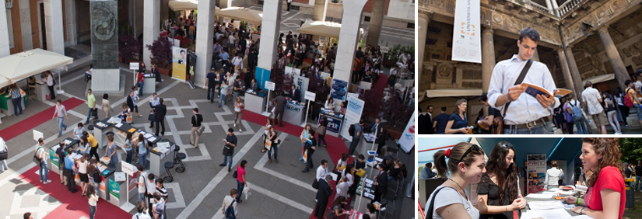
Career Days
End of May: Università Aperta http://www.universitaperta.com/
Beginning of November: Università Aperta Ingegneria http://ingegneria.universitaperta.com/
Services offered:
Desk and lunch
Catalogue and flyer
Web site
Workshops
Sponsorships
Students involvement
Professors involvement

Slide 26
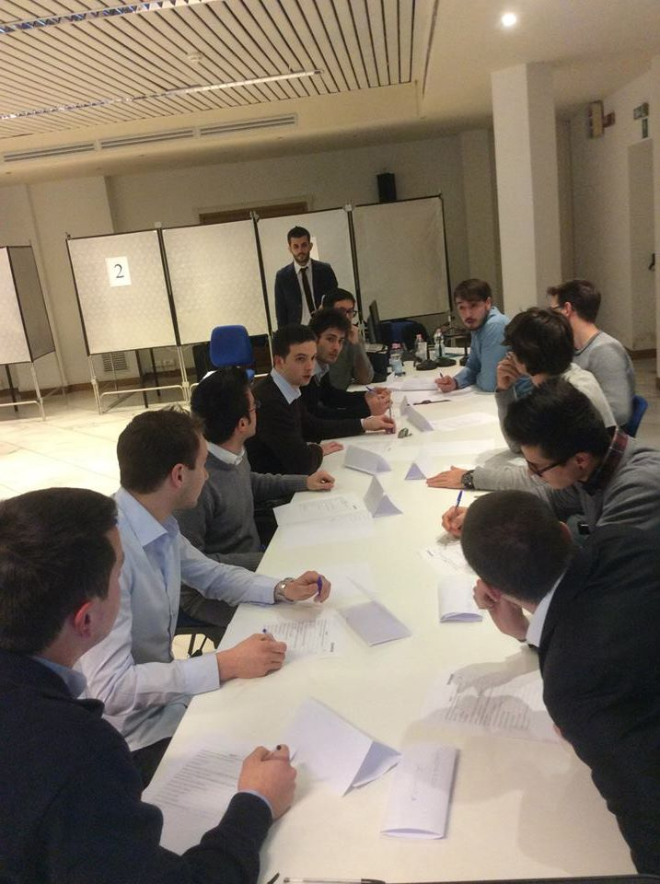
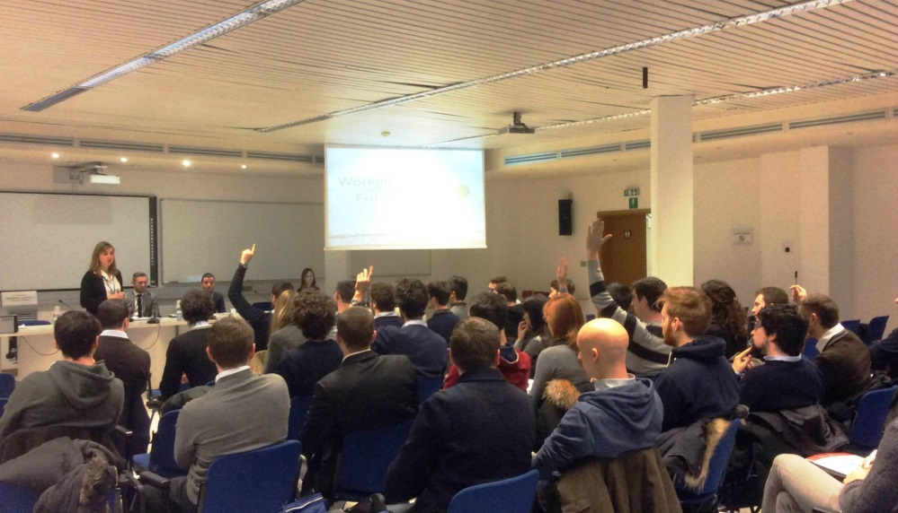
Company meetings at the University
Standard
Assessment day
Services offered:
Lecture room
Technological equipment and support
Students involvement

Slide 27

Company tour
Participant profile
Professors involvement
Guided visit of the company
Assessment

Slide 28

Career Virtual Fair www.careervirtualfair.com
International on line event dedicated to:
  Companies looking for foreign students and graduates
  Universities promoting their educational offer abroad
  University students and graduates whishing to have a placement experience abroad

Slide 29


Communication channels for the activities
 | Institutional website | Event website | Social networks | Students mail and SMS | Flyers
Internships and job offers
Career days
Company meetings
Company tour
Virtual fair

Slide 30

How to reach companies?
Company databases, Chamber of Commerce lists, sectorial fairs
Students internships
Professors involvement
Local job market observatory
University networks
Social networks
… word of mouth!

Slide 31
CONCLUSIONS
ENABLING THE STUDENTS TO FINDING AND FOLLOWING THEMSELVES AND THEIR CAREER PATH IS THE CORE RESPONSABILITIES WE HAVE
IN ORDER TO DO OUR WORK EFFECTIVELY WE NEED TO OFFER A RANGE OF SERVICES AND ACTIVELY BUILD SOLID, LONG –TERM RELATIONSHIPS WITH EXTERNAL PARTNERS
AS CAREER SERVICE WE ARE NOT ONLY COUNSELLORS AND TEACHERS BUT WE ARE EDITORS, NETWORKERS, BRAND MANAGERS, EVENT MANAGERS AND FUND-RAISERS. OUR WORK HOLDS HUGE POTENTIAL FOR OUR STUDENTS, UNIVERSITIES AND FOR OUR PARTNERS IN THE CORPORATE WORLD. IN ORDER TO FULLY DEVELOP THIS POTENTIAL WE NEED LONG-TERM FINANCIAL SECURITY

Slide 32
Thank you for your attention!
www.careerservicepd.com
www.unipd.it/stage
www.unipd.it/placement

