Slide 1
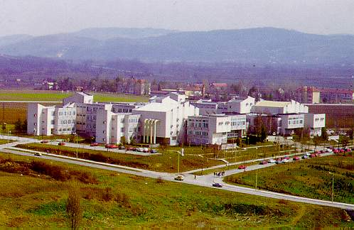
UNIVERSITY OF KRAGUJEVAC
http://www.kg.ac.rs

Slide 2
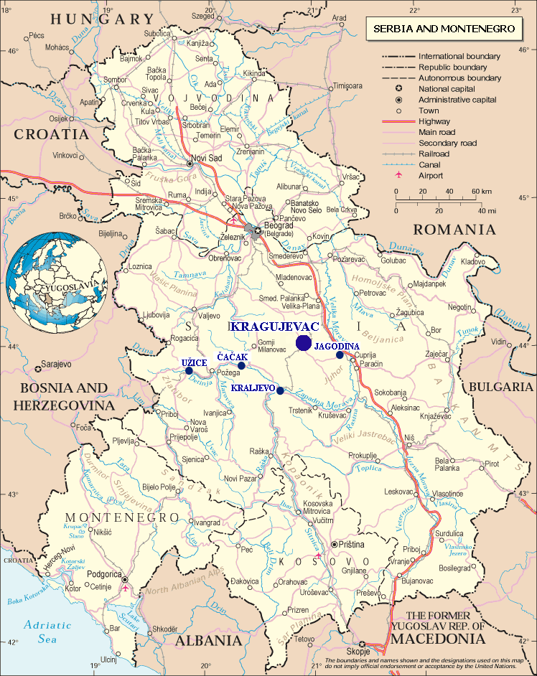
UNIVERSITY OF KRAGUJEVAC
Where are we:
Kragujevac
Čačak
Kraljevo
Užice
Jagodina
Vrnjačka Banja
Historical facts:
in 1838 “Licej” was established
University of Kragujevac was
founded on May 21, 1976
at first we had 5 faculties

Slide 3
UNIVERSITY OF KRAGUJEVAC
The University comprises 12 faculties:
Faculty of Economics
Faculty of Law
Faculty of Engineering Sciences
Faculty of Science
Faculty of Medicine
Faculty of Philology and Arts
Faculty of Agriculture in Cacak
Technical Faculty in Cacak
Faculty of Mechanical Engineering in Kraljevo
Teachers’ Training Faculty in Uzice
Faculty of Pedagogy in Jagodina
Faculty of Tourism and Hotel Management in Vrnjacka Banja
Total number of students: 17 000
Total number of teaching staff: 1050

Slide 4

UNIVERSITY OF KRAGUJEVAC
  Centre for Career Development and Student Counseling
  University of Kragujevac

Slide 5
CENTRE FOR CAREER DEVELOPMENT AND STUDENT
COUNSELING
Who are we?
Centre for Career Development and Student Counseling is an organizational unit of the University of Kragujevac whose objective is to prepare students for labor market after their graduation, to connect them with employers and to support them in gaining the knowledge and skills needed for modern business society.

Slide 6
CENTRE FOR CAREER DEVELOPMENT AND STUDENT
COUNSELING
BRIEF INFORMATION
  Centre was established in October 2007
  At this point we have about 1000 active service users
  Network of associates on each faculty
  Well equipped library concerning career guidance literature
  Computers and free internet access for students
  Large CV database of University students and graduates

Slide 7
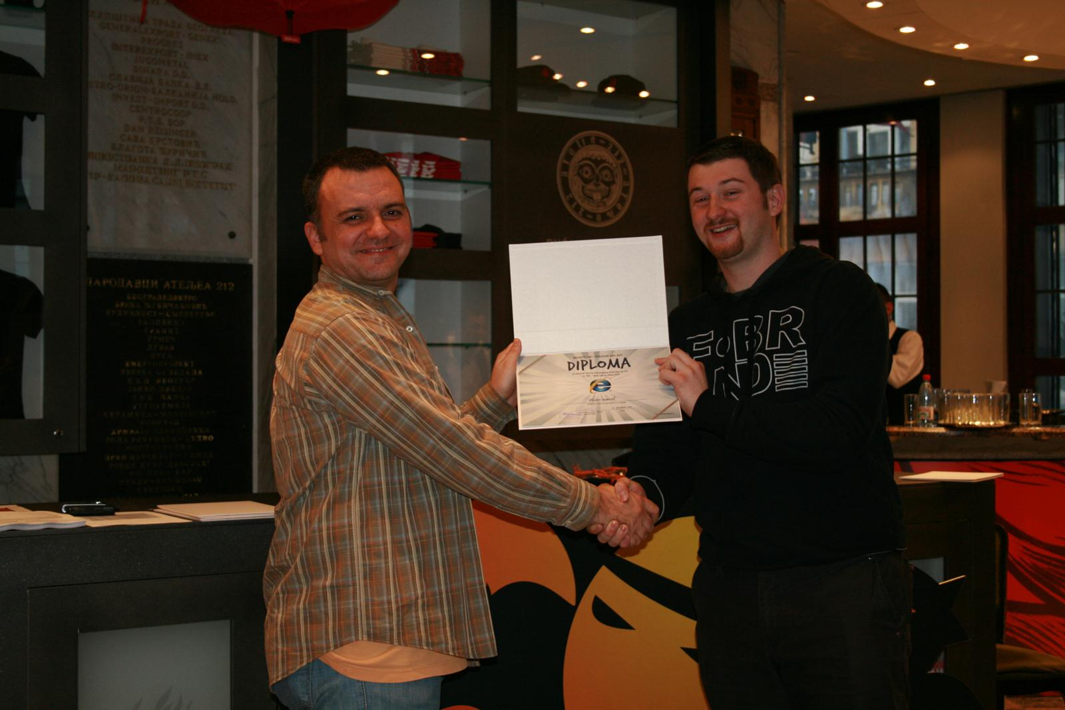
CENTRE FOR CAREER DEVELOPMENT AND STUDENT
COUNSELING
INTERNSHIP PROGRAMS-THE BEST WAY FOR GAINING PRACTICAL EXPERIENCE

Slide 8
CENTRE FOR CAREER DEVELOPMENT AND STUDENT
COUNSELING
Knjaz Milos
ComTrade IT Solutions and Services/Spinnaker New Technologies
Institute for Public Health Kragujevac
Limessoft and sportske.net
Fond Zoran Djindjic and DAAD Info Centre
Tetra Pak
Emisia Consulting d.o.o
KMF Ekonomac
Fiat Automobiles Serbia
Muehlbauer
Wacker Neuson d.о.о.
Hoedlmayr Zastava d.o.o.

Slide 9
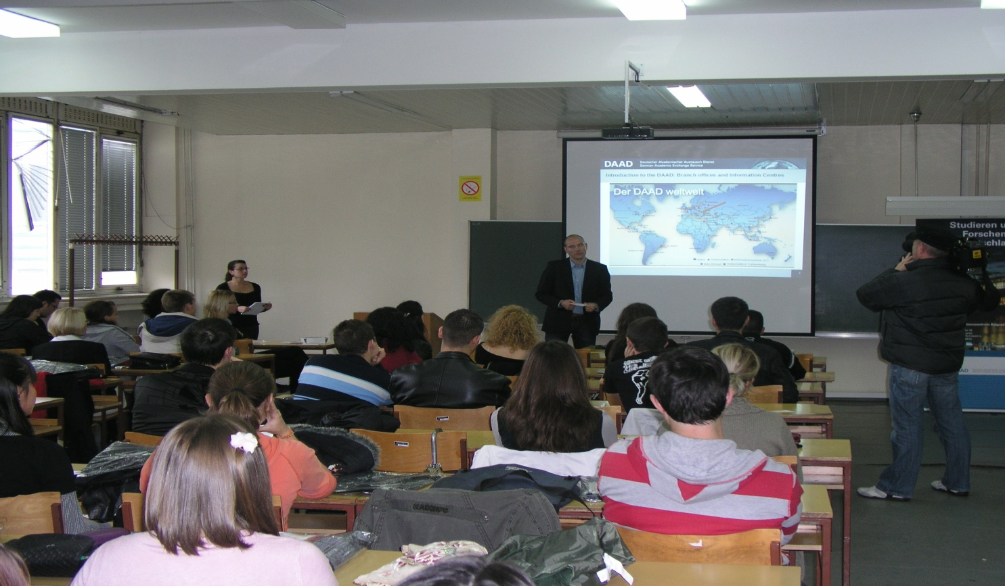
CENTRE FOR CAREER DEVELOPMENT AND STUDENT
COUNSELING
ADVERTISING FOR VACANCIES
PART-TIME AND TEMPORARY JOBS
PRESENTATIONS OF COMPANIES
INTERNSHIP AND SCHOLARSHIP PROGRAMS
COLLECTION OF CV’S AND PRE-SELECTION
OF CANDIDATES

Slide 10
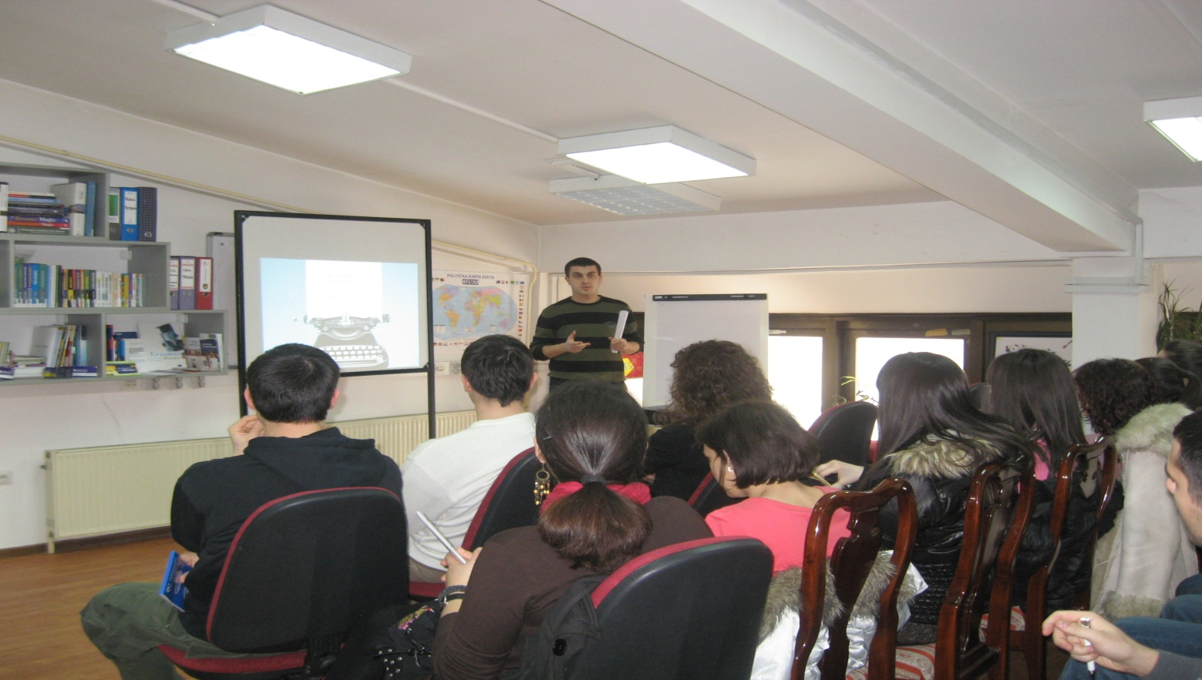
CENTRE FOR CAREER DEVELOPMENT AND STUDENT
COUNSELING
WORKSHOPS AND LECTURES ON FACULTIES AND IN THE CENTRE
STUDENT PROJECTS
PRESENTATIONS ON FACULTIES AND IN THE CENTRE
PROMOTIONS ON FACULTIES AND IN THE CENTRE
EFFICIENT INFORMATION SYSTEM

Slide 11
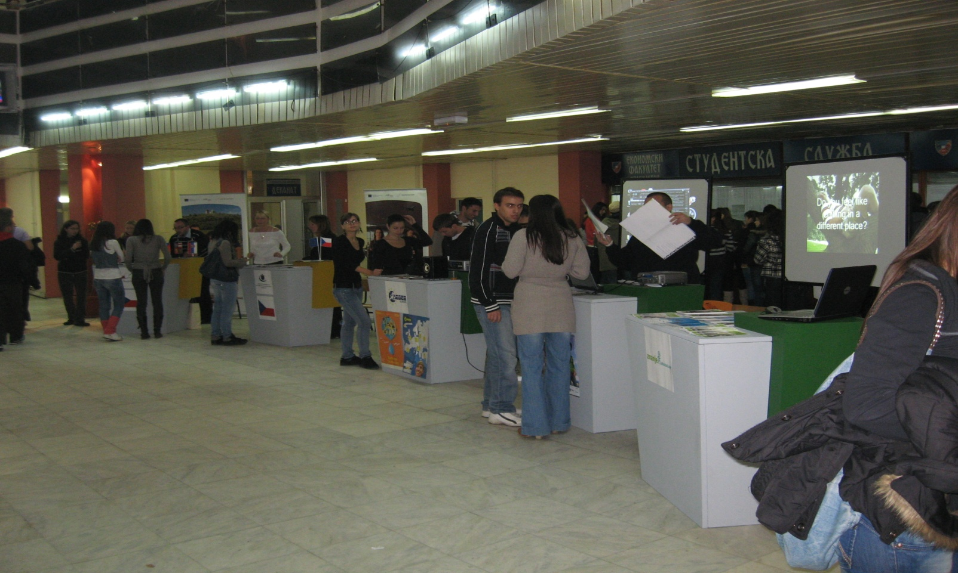
CENTRE FOR CAREER DEVELOPMENT AND STUDENT
COUNSELING
SCHOLARSHIP FAIR
STUDENTS DAYS FAIR

Slide 12
CENTRE FOR CAREER DEVELOPMENT AND STUDENT
COUNSELING
THANK YOU FOR YOUR ATTENTION

