Slide 1


Slide 2
CONTEMPORARY ECONOMIC CONTEXT OF EDUCATION AND EMPLOYMENT
Reflection on the national context:
When it comes to the Republic of Serbia we can say that:
development, reconstruction and transformation of the entire education represents one of the prerequisites of the whole social and economic development of the country as a whole.
The National Employment Strategy for the period 2005 – 2010 is based, amongst other, on the assumption that a population in possession of social competencies necessary for a successful participation in the society, and trained and adaptable labor force, are both the prerequisite, and the condition of a social and economic transformation of the Republic of Serbia, its integration into the EU, and the adequate response to the challenges of technological development and global economy.

Slide 3
CONTEMPORARY ECONOMIC CONTEXT OF EDUCATION AND EMPLOYMENT: Place of an Individual Within the Ever-changing Professional and Socio-Economic Environment
Therefore, each participant in the process of education, but also in the process of work, poses the question:
Q: What does the 21st century demand besides reading, writing and computer literacy skills?
The answer would be that, first of all, it demands of the individual to know how to use knowledge and skills in the context of modern life.
Successful economy requires the individuals to quickly and easily adapt to the changeable demands of the world around them, but also to know those changes and be able to manage them.
In short, today’s economy values and looks for wide skill-base, including critical thinking, problem solving, teamwork and decision making skills, flexibility, and project work.

Slide 4
CONTEMPORARY ECONOMIC CONTEXT OF EDUCATION AND EMPLOYMENT
LEARNING FOR EMPLOYMENT
Core Concept
Numbered skills underpin vertical and horizontal learning for employment means developing abilities to find, keep and change job or to generate self-employment mobility of employees in the labour market and their adaptability to changes in technologies and new forms of work organization. That is a demand that each country and society encounter, whether they are a transitional economy or not.

Slide 5
CONTEMPORARY ECONOMIC CONTEXT OF EDUCATION AND EMPLOYMENT
Career guidance and counseling are one of the very basic instruments to contribute to:
realization of the elementary right to work;
more efficient investment in education and training;
greater efficiency in the labour market, which is reflected by a greater employability and mobility of the labour force;
human capital and labour development;
social inclusion and social equality of each individual;
active citizenship.

Slide 6
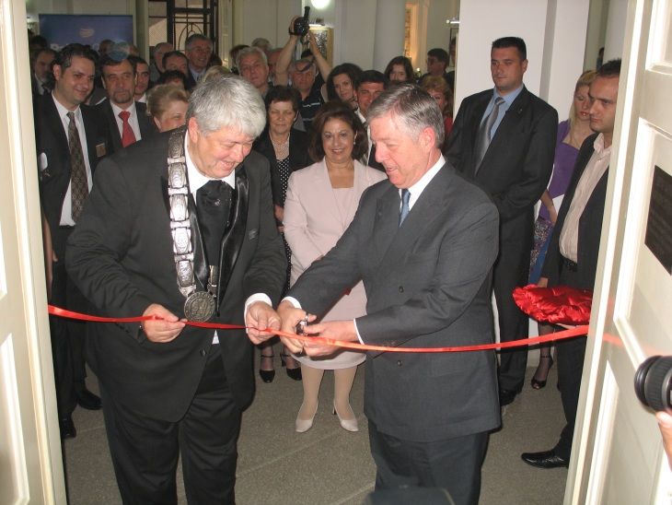
Local Level : University of Nis
Center for Career Development
Center for Career Development is an organizational unit of the University of Nis. Center for career development was established to support students of all levels in development of skills and abilities that are crucial for their employment, as well as to provide information on education and scholarship opportunities, both national and international…
The Center was opened in June 2008, with the help of Foundation /of Crown Prince Alexander for Education and the University of Nottingham.
One of the key roles of the Center is networking of the academic and business community and providing information and services in support of more eﬃcient multi-sector cooperation.
The Centre is not directly involved in the recruitment of students and graduates, instead it provides relevant information about getting a job, connects students with employers by the means of organizing internships and voluntary work and by organizing training and seminars.
The Center is entirely University-sponsored.

Slide 7
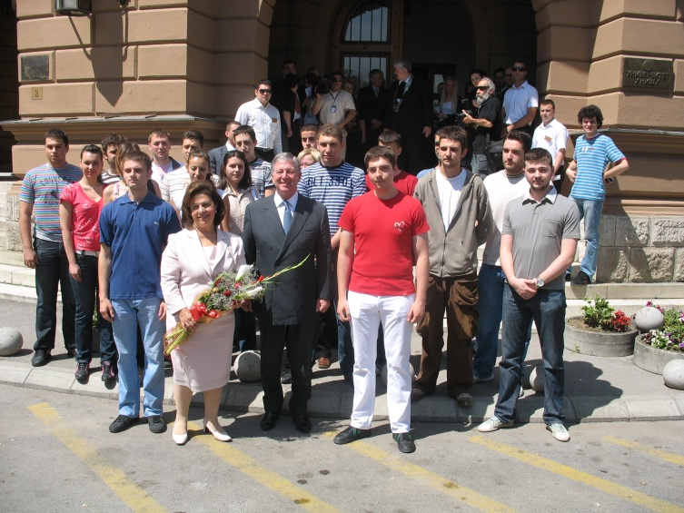
Local Level : University of Nis
Center for Career Development
Activities:
The Center monitors and analyses the student admission and eﬃciency of studying, prepares informative publications, internet presentations and other forms of introducing the possibilities of studying at the University to the potential students, establishes contacts with relevant employment services, collects information on employment opportunities for students, creates unique database on University alumni employed in country or abroad, organizes meeting of students and potential employers. Center has its director and the corresponding council.
Web portal of this center is www.karijera.ni.ac.rs

Slide 8
CURRENT SITUATION
Previous activity
Center for Career Development in 2009/2010 gave the assistance though:
Assistance in the preparation of (CV), supporting letters, job applications.
Personal career development guidance
Advising and preparation of students for job interviews.
Providing information on practices, volunteering and scholarships.
Oranization of workshops, trainings and seminars.
Organization of presentation of enterprises and meetings with employers.
Printing of brochures with tips for hiring and career development.
Ensuring availability of professional literature.
Providing computer and internet access to students

Slide 9
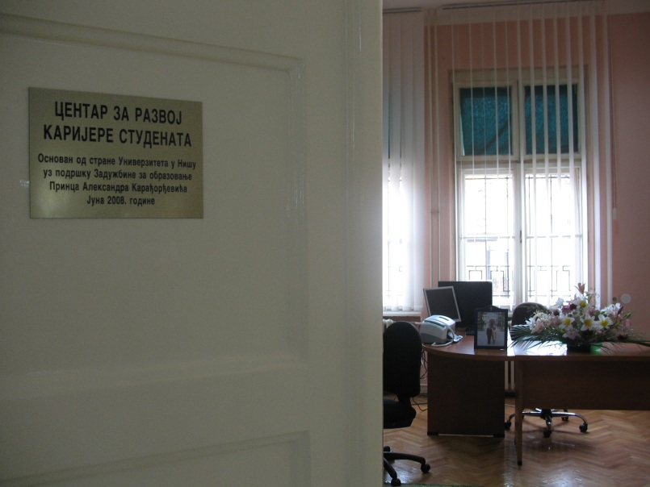
CURRENT SITUATION
In the previous period, the Center for Career Development the University of Nis achieved successful cooperation with various institutions, organizations, etc. in various fields of activity. Some of them are:
Crown Prince Alexander II Foundation for Education
"USA Summer Work and Travel“
Ministry of Youth and Sports
of the Republic of Serbia
National Employment Service
of the Republic of Serbia
Federal Ministry of Labour and Social Affairs of Germany
"Community Connections"
World Learning Center Programme
Ministry of Education of the Republic of Serbia
World Trade Center in Baltimore, USA - USAID
Coca-Cola Hellenik Serbian Company
Embassy of the Republic of Austria
Walton International UK

Slide 10
Local Level: FURTHER DEVELOPMENT
Capacity Building
Taking into consideration that the Center is understaffed, in comparison to other national career centers, and with strictly limited absorption capacity to answer the growing demands and provide the most efficient and professional service, it needs to be able to increase its activities in each respective Sector, improve the expertise of its staff through various targeted trainings and exposure to good model practices from the European universities. The improvement of the mentioned aspects of the Center will facilitate organization and wider implementation of training programs and workshops for our students, employers and companies presentations etc.

Slide 11
Local Level: FURTHER DEVELOPMENT
STRATEGY
The draft of general strategy for capacity building can be addressed through differentiated sectors, according to their functions:
Sector for working with students
Sector for cooperation with business community and economic entities
Sector for general functioning of the Centre (daily activities of the Centre, media cooperation and providing means for further development of the Centre)

Slide 12
Local Level: FURTHER DEVELOPMENT
The main goal of the Centre is to
create the multi-sector platform to address the improvement of the students’ employability in a sustainable way through the system approach by connecting the academic and the business community.
One of the modalities informing this strategy is student oriented, through supporting students and graduates in developing practical skill base and generating professional experience, as well as other added competitive assets. The other key activity underpinning the employability capacity of student population is focused on awareness raising and information dissemination of employment and further education possibilities (post-graduate studies, scholarships, internships, fellowships...)
The Center also aspires to introduce the ongoing dialogue between the students and employers aimed at bridging the gap existing in the employment, employment demand and absorption capacities, as well as to help employers identify and better articulate their needs in terms of demands of the future employees, their education and specific expertise. There is a range of services aimed at the employers so that the cooperation would be successful and a long-term one.
.

Slide 13
Local Level: FURTHER DEVELOPMENT
Trainings for Employees
In order to raise the quality of career counseling, it is necessary to organize additional training of employees through seminars and workshops, so as to increase the package of trainings and workshops that would allow students to gain additional knowledge and skills essential in the sphere of employment through non-formal education (presentation skills, time management, how to search for and select the most suitable job, ice breaking- how to introduce yourself and start a conversation on employment fairs etc; web journalism, project proposal writing etc.)

Slide 14
Local Level: FURTHER DEVELOPMENT
Improvement of the website for career guidance and counseling
Through its website, the Center ,on regular, basis informs students about present programs of internships and volunteering, scholarships, open calls, as well as professional and student seminars and conferences, courses, lectures and workshops.
The goal is to enrich the content of the website with sections as:
client database (students and employers), video CVs
professional development database
virtual assistance module (provides practical information, FAQa, Know-how’s, job interview tips, etc.)
media library
alumni database
forum
platform for integrating with social networks (FB, Twitter, etc.)

Slide 15


