Slide 1

CareerS partner meeting
Gilda Rota, The University of Padua
Belgrade, 30/1/2012

Slide 2



University of Padua
History
The university was founded in 1222 when a large group of students and professors left the University of Bologna in search of more academic freedom 'Libertas scholastica'.
From 15th to 18th century, the university was renowned for its research, particularly in the areas of medicine, astronomy, philosophy and law.
This was thanks in part to the protection of the Republic of Venice, which enabled the university to maintain some freedom and independence from the influence of the Roman Catholic Church.
During this time, the University adopted the Latin motto: Universa universis patavina libertas (Paduan Freedom is Universal for Everyone).

Slide 3
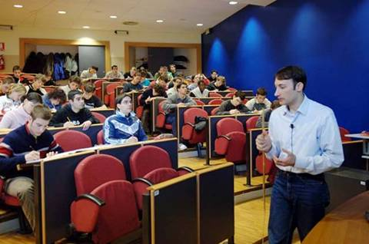

University of Padua
List of Faculties
The University of Padova offers a wide range
of degrees in 13 faculties:
Faculty of Agriculture
Faculty of Humanities
Faculty of Economics
Faculty of Education
Faculty of Engineering
Faculty of Law
Faculty of Mathematical, Physical and Natural Science
Faculty of Medicine and Surgery
Faculty of Pharmacy
Faculty of Political Science
Faculty of Psychology
Faculty of Statistical Science
Faculty of Veterinary Medicine

Slide 4
University of Padua
Students 2011
Graduates 2010
Teachers 2010
Administrative Staff 2011
60.401
11.610
2.214
2.264

Slide 5
The Career Service of
the University of Padua
Dr.ssa Gilda Rota – Director

Slide 6
Career Service
Activities Structure
MACRO - SECTORS
INTERNSHIPS IN ITALY AND ABROAD
CAREER GUIDANCE
PROJECT
MANAGEMENT
LOCAL JOB MARKET OBSERVATORY
JOB PLACEMENT

Slide 7
Career Service
Database Structure
COMPANIES
STUDENTS & GRADUATES
Career Service
OFFERS
INTERNSHIPS
JOBS

Slide 8
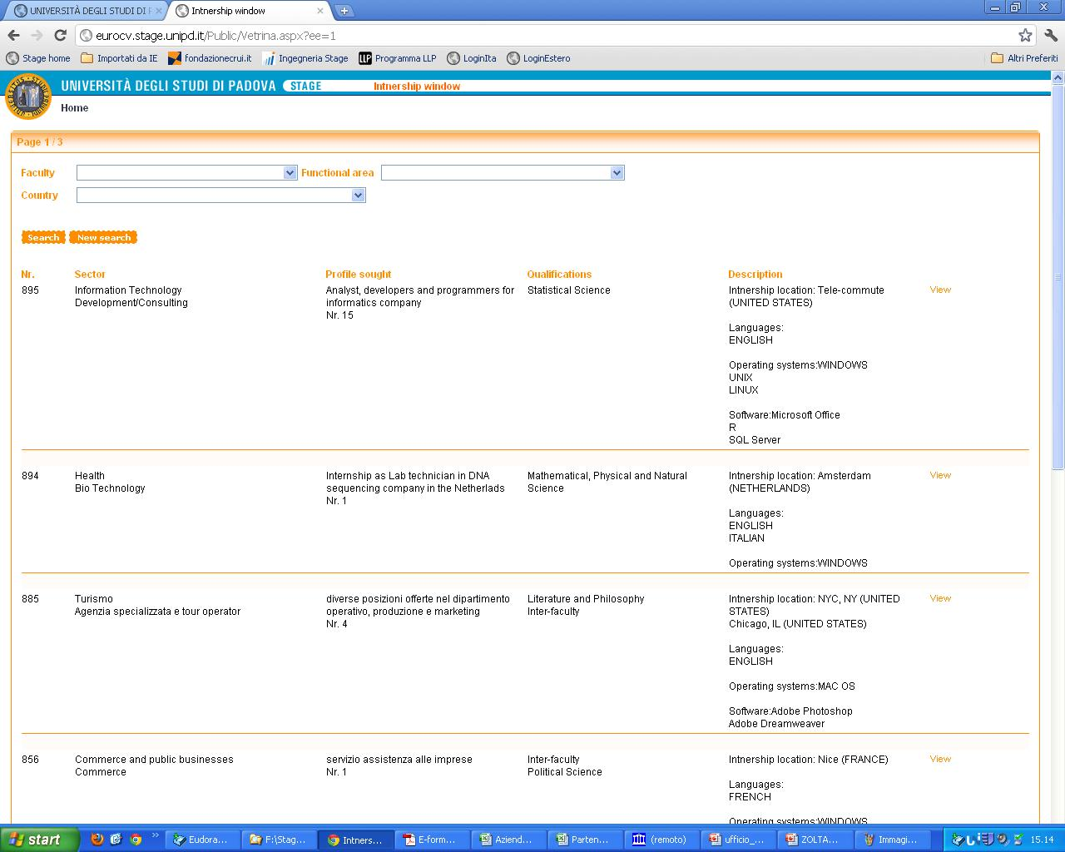
Internships for students and graduates
Italian and International Companies register to the www.unipd.it/stage site and then post their internship offer (in Italy and abroad) directly on the website showcase.

Slide 9
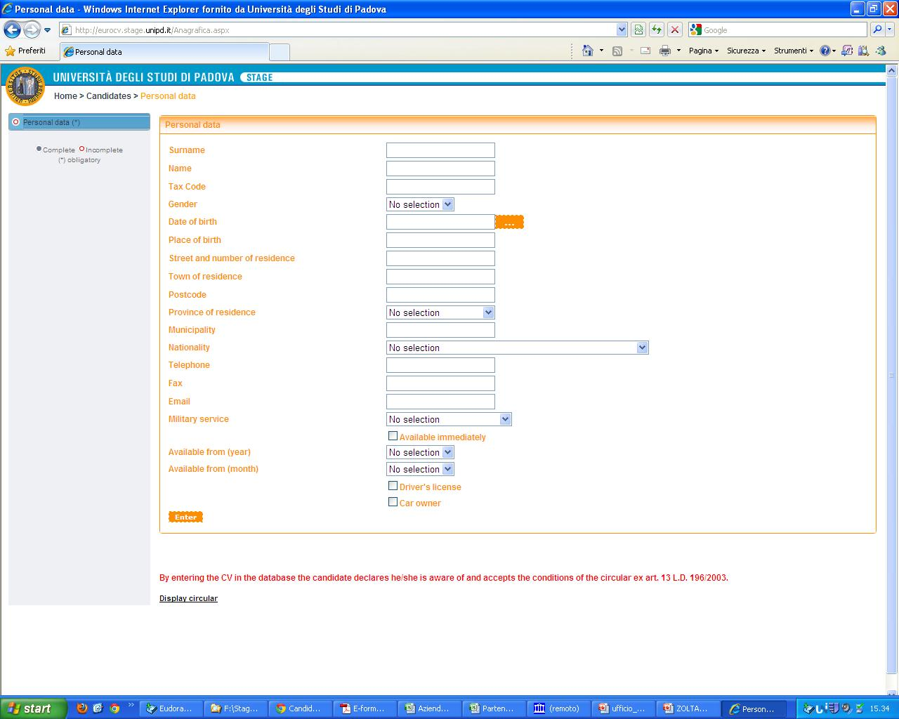
Internships for students and graduates
Students and graduates access the www.unipd.it/stage site with their username and password in order to upload their CV data and then to apply directly to internship offers.

Slide 10
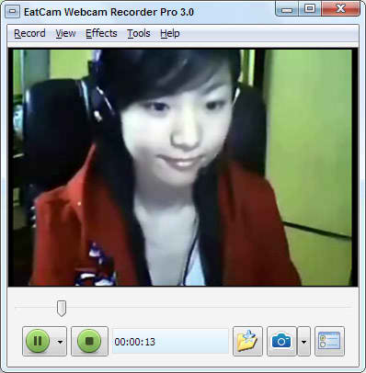
Career Service
Video CV
We are all aware of the importance of a study experience abroad, but even more important nowadays is an internship or work experience in a foreign company.
Through the Video CV our students can record a 2-minutes’ virtual presentation of themselves using a webcam.
This innovative tool gives the chance at meeting up more efficiently with foreign companies (better understanding of foreign language, of attitude, self confidence).
Moreover, we offer companies face-to-face interviews with applicants by using the virtual remote interviews tool.

Slide 11
Internship Website English Version
Companies and students/graduates access
www.careerservicepd.com
Website in English and in Italian
Companies and students/graduates access by username and password
Internship and Job Offers uploaded directly from companies
Students/graduates online application and video cv recording
Career Service staff screening and matching
Companies can examine online selected cv
Contact with the Career Service for the start up of job/internship experiences

Slide 12

Internships observatory
Final Evaluation
At the end of the experience an e-mail with Username and Password is sent both to companies and to interns.
The mail contains a link to an online questionnaire to be filled in for the final evaluation
The Internships Observatory collects and analyses the answers and gives a report

Slide 13
Internships
Trend of internships in Italy

Slide 14
Internships
Trend of internships abroad

Slide 15
Internships
Job offers after an internship

Slide 16
Internships
326 Internships abroad

Slide 17

Career Guidance
Job Counselling
It offers assistance in writing out skills assessments, with the aim of identifying the job sector which is most suitable to the applicant’s abilities. We also assist with writing CVs and in best preparing for job interviews.
1-2 day seminars on useful topics to best prepare candidates to find a job
Individual interviews /counselling
Courses funded by the European Social Fund aimed at job seekers
Skills assessments
Companies’ presentations

Slide 18

Job Placement
Since 2005, the University of Padova has been playing the role of job agents to help their students and graduates find quick, suitable job placement.
Job Placement has been created for:
graduates and students of the University of Padua who are searching for their first job positions or new career opportunities;
companies in search of professional figures.
CVs and job offers are entered directly online and constitute easy access, highly useful databases.
Specialized Job Placement personnel act as intermediaries between job requests and offers.

Slide 19

Local Job Market Observatory
The “Local Job Market Observatory” aims to:
Reinforces relations between the University and Companies
Investigates on how long it takes for our graduates to find a job and which are the positions they fill, through longitudinal surveys on graduates
Identifies professions skills required by local employers, through face to face interviews
Survey results are discussed during specific seminars.
Survey results have been published in “PHAROS” series, for download go to www.unipd.it/osservatoriolavoro.

Slide 20

Local Job Market Observatory
Analysis of product sectors - Pharos

Slide 21

Local Job Market Observatory
Graduates’ Survey
Aims:
  To know what kind of jobs the students of the University of Padua will get after graduation
  To know if there is a link between degree and career
  To know which are the working conditions of the graduates
  To know which skills and competences are required and which ones are used
Procedures:
  On line questionnaire (before the degree)
  Computer Assisted Telephonic Interview (CATI) every six months for 3 years (after the degree)

Slide 22

Project Management
  High Apprenticeship
  SUV: Sistema Universitario Veneto per la Mobilità Professionale e Formativa (Regional University System on professional Mobility)
  MOIRC: Modello Operativo Integrato per il Riconoscimento e la Certificazione delle Competenze (Operative Model for Skills Recognition and Certification)
  EU-VIP: Enterprise – University Virtual Placements (2010/11, LLP Erasmus Multilateral Projects)
  UNI-LO: Promoting the EQF learning outcomes approach within European Universities (2010/11, LLP EQF Projects)

Slide 23
Thank you for your attention!
www.careerservicepd.com
www.unipd.it/stage
www.unipd.it/placement
stage@unipd.it, stage.estero@unipd.it

