Slide 1
SWANSEA UNIVERSITY WALES, UK
Pauline McDonald
Head of Careers and Employability
Chris Cardew
E-learning and PDP

Slide 2
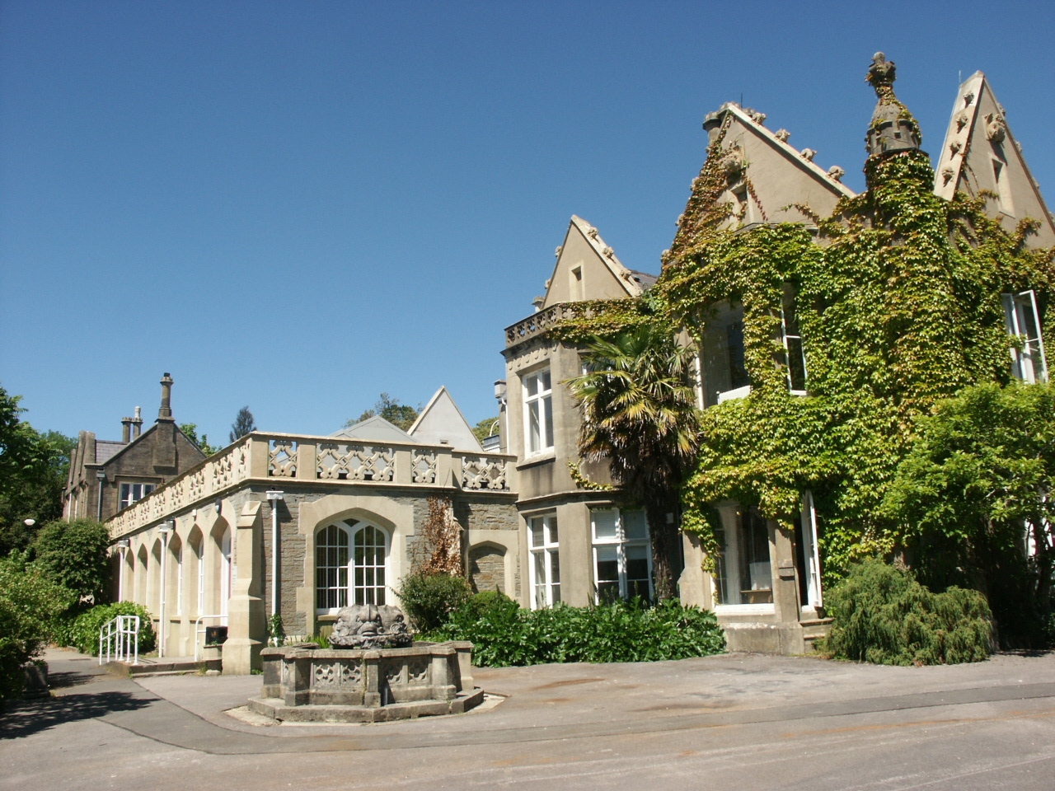
The Abbey Building, Swansea University

Slide 3
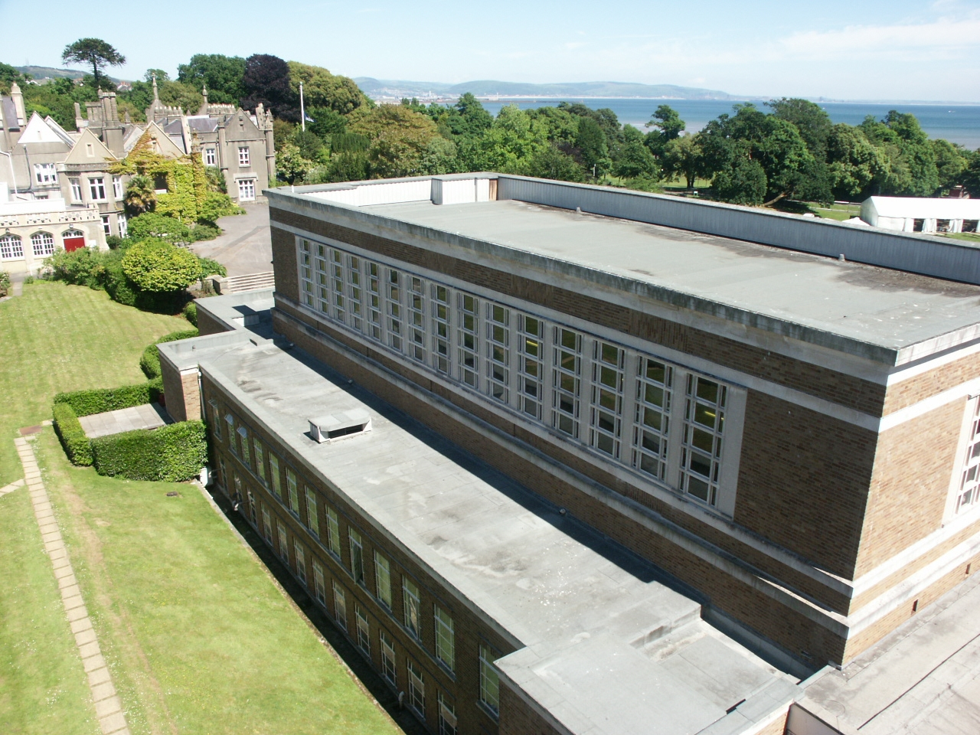
Our Location

Slide 4


Slide 5


Slide 6
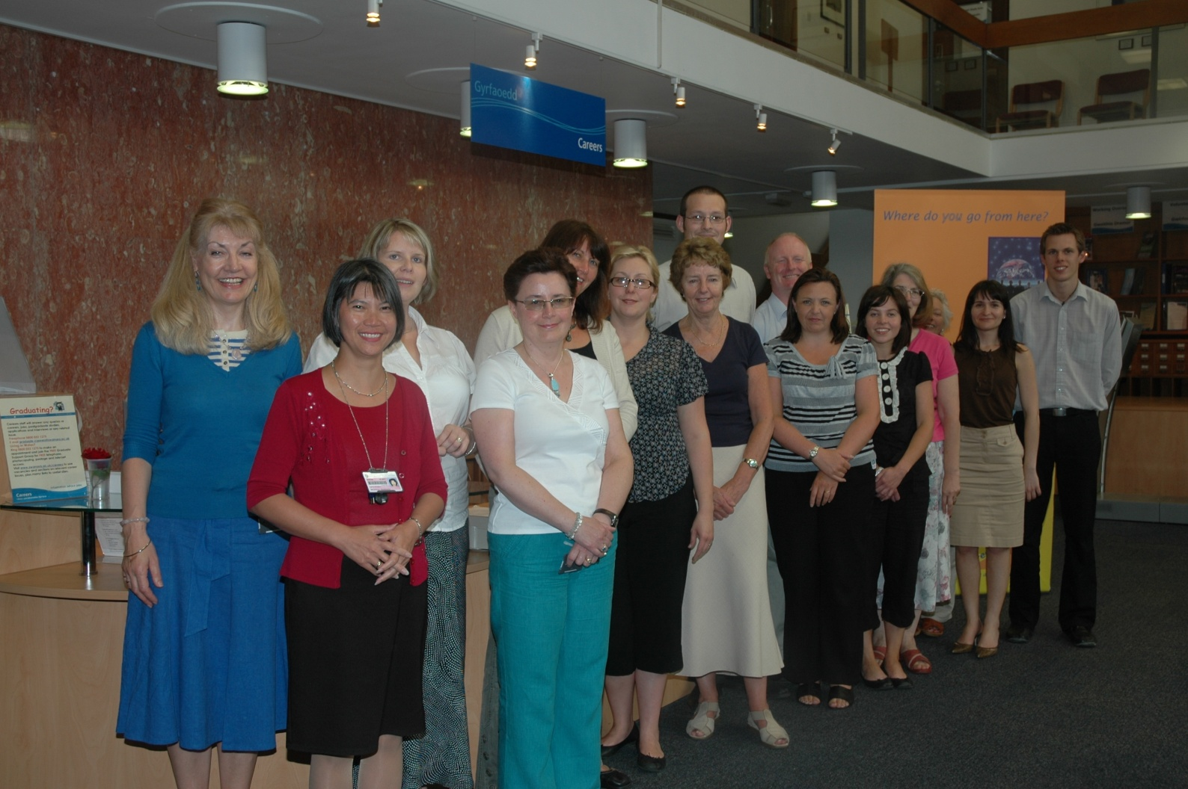
Meet the Careers and Employability Team

Slide 7
Roles and Responsibilities
Pauline McDonald
Head of Careers
and Employability
Senior Careers
Advisers
Jean Brokenshire
Rebecca Vaughan
Jo Davies
Careers Information
Officer
GoWales
Senior Marketing
Manager
Alysha Morgan
Support Team
Crystal Evans
Janet Mosson
Michael Hargreaves
Steve Poole
Rhian Evans
Jennifer Evans
GoWales
Placement and
Careers Advisers
Paula Williams
Zdravka Kamenova
Placement Support
Team
Lucy Williams
Jade Goodwin
E-learning and
Personal
Development
Planning
Chris Cardew
Reception Help
Desk and
Information Assistant
Tricia John
Employer Assistant
Linda Palmer

Slide 8




Matching graduates with employers
Partners
Career planning.
Vacancies
Professional Institutions
Local Jobs, placements in Wales
Notes:
GoWales concentrates on placements, tasters and jobs based in Wales
GradIntel – matches graduates with employers
Prospects – Career planning
AGCAS – UK wide professional body, great support within the community by email
Example of the support email that comes into the link
Email is still new for some in this community

Slide 9











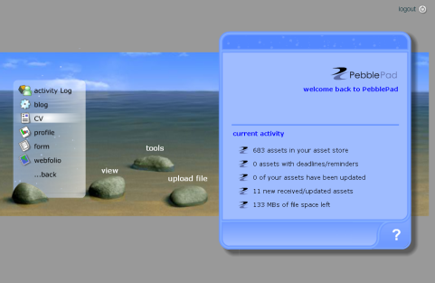


Social Networks
Social Bookmarking
Other things
Video things
Notes:
Emerging technologies in Careers
The growth of the internet, its accessibility to the general public and the ease with which we can now so easily edit the web ourselves (web 2.0) has meant that students and graduates are online more and more. Employers have much more web presence. We need to be using new web 2.0 features and engaging with students more and more

Slide 10
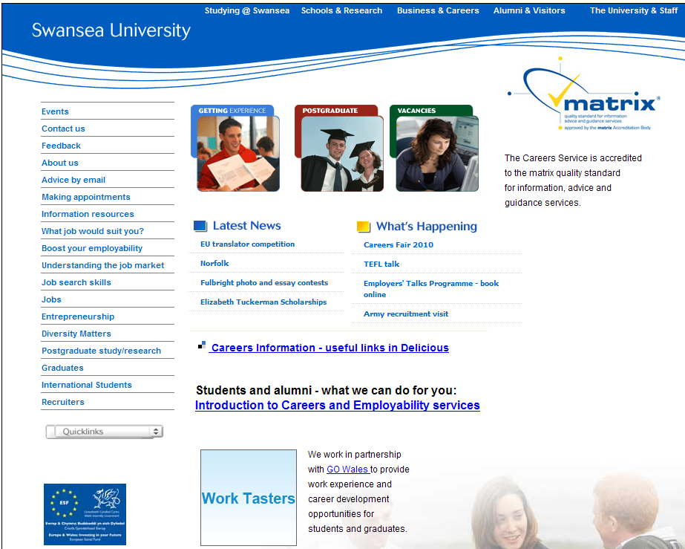

Slide 11
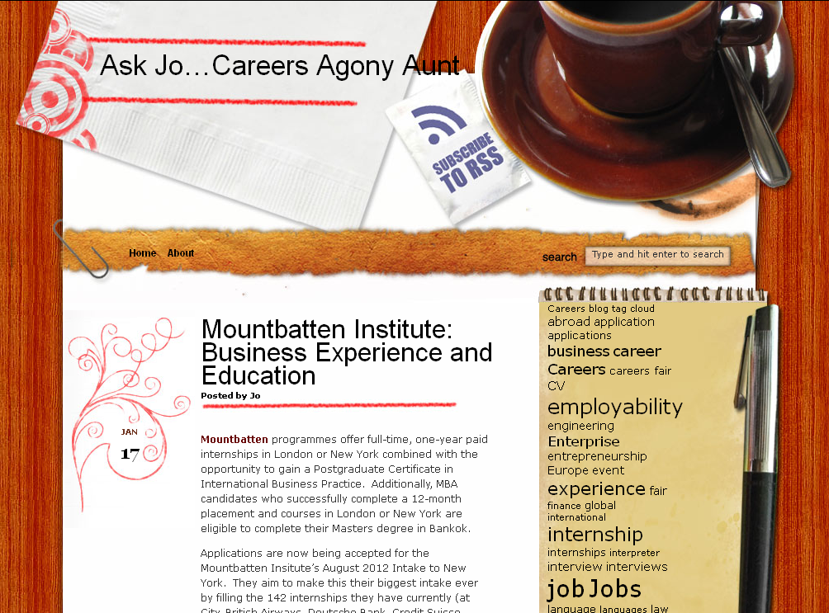

Slide 12
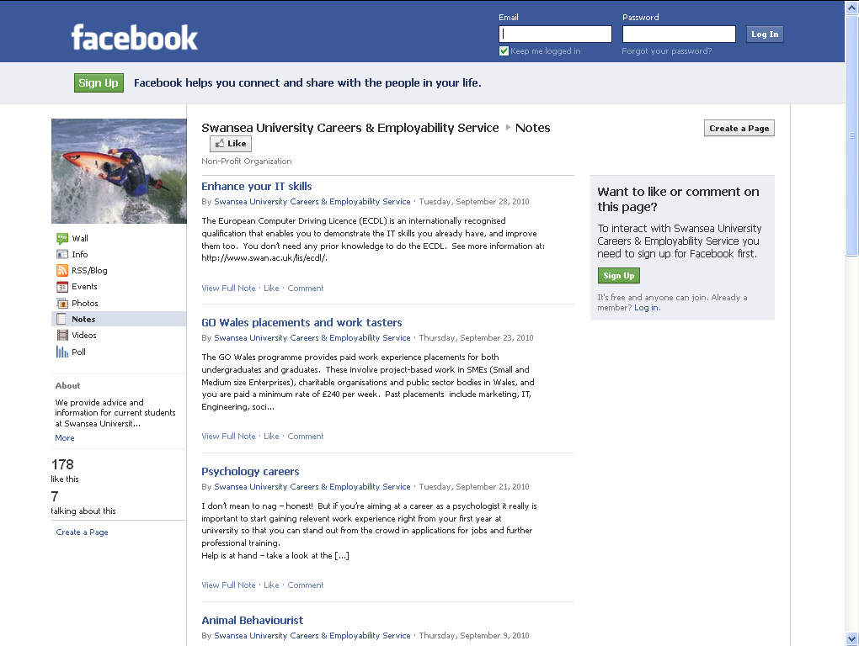

Slide 13
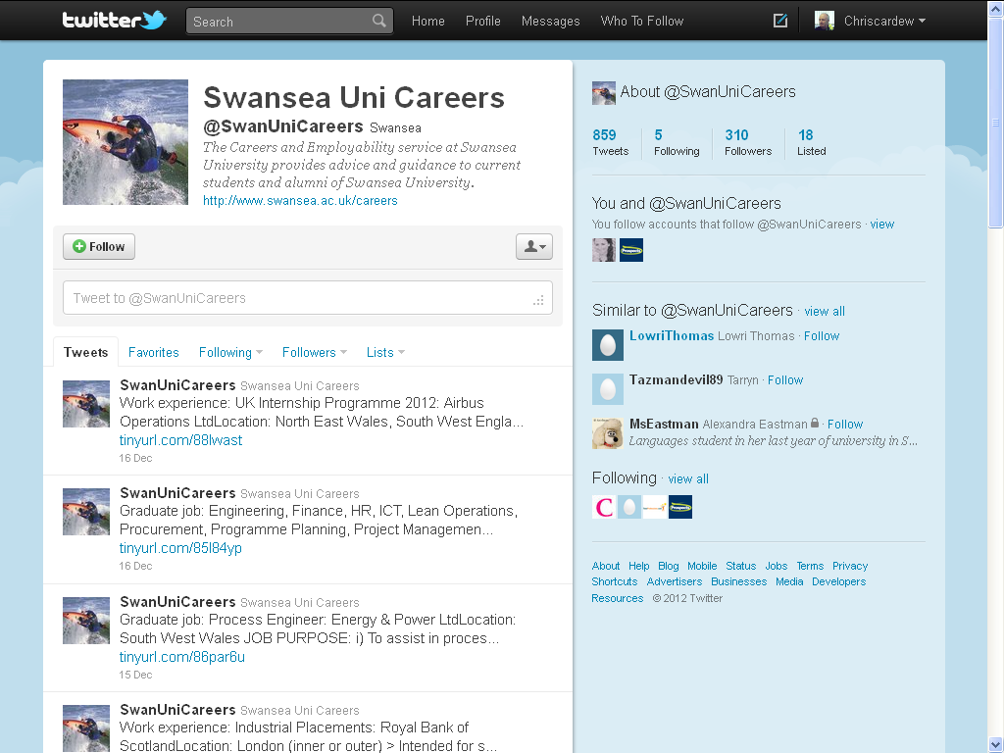

Slide 14
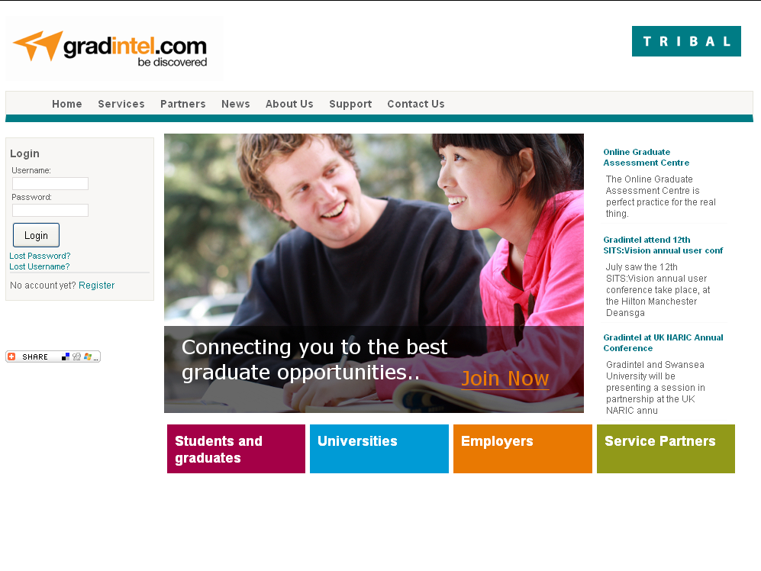

Slide 15
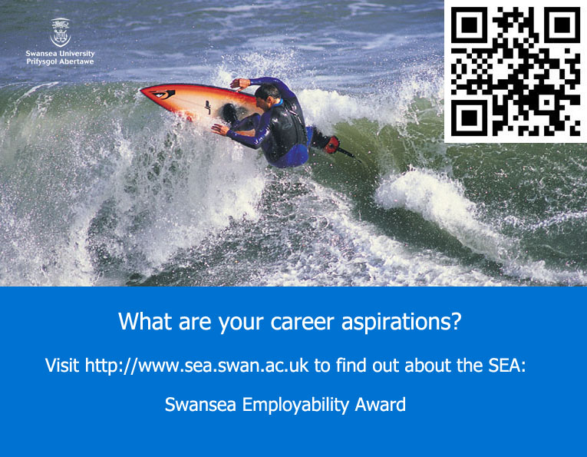

Slide 16
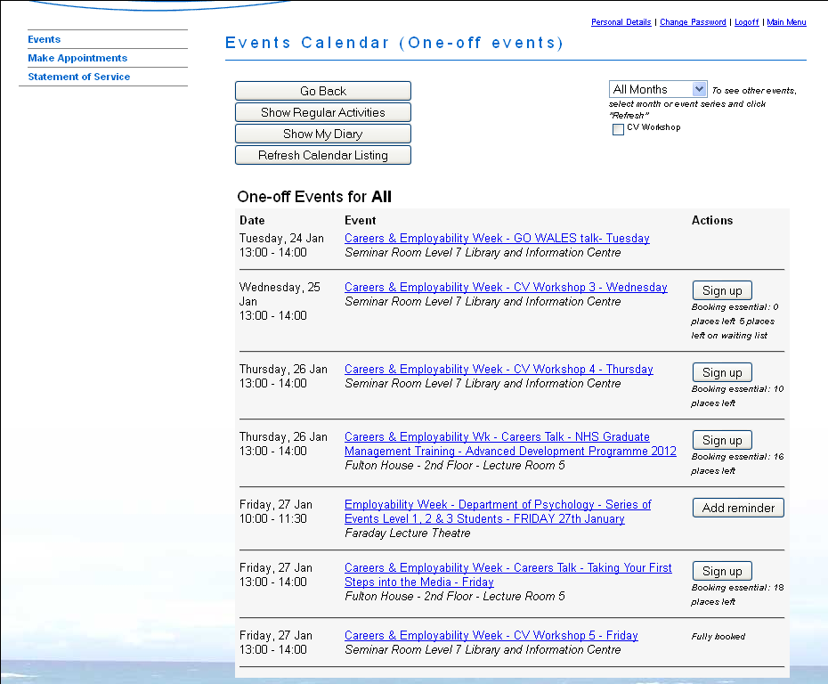

Slide 17
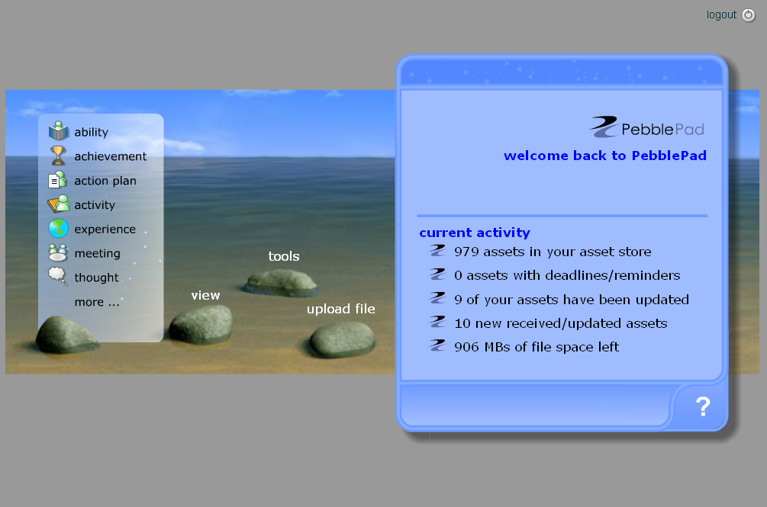
Personal Development Planning
E-portfolios
Reflecting on Learning

Slide 18
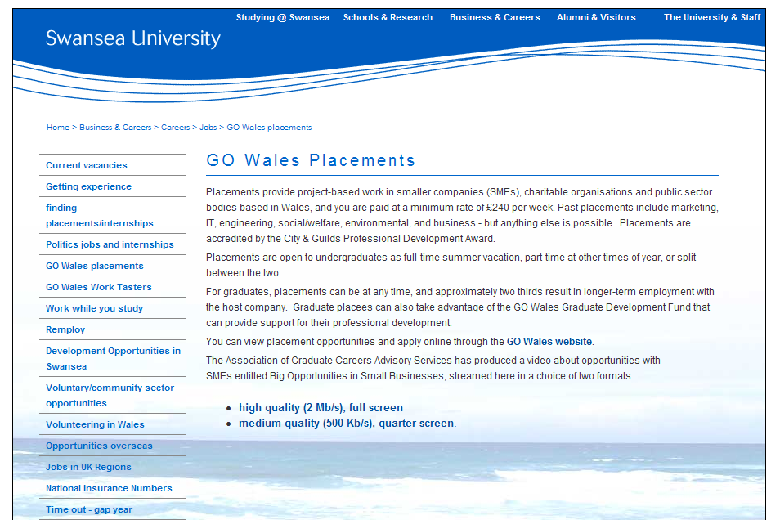
Go Wales Work Placements

Slide 19

Diolch yn Fawr iawn
Diolch yn Fawr iawn

