Slide 1


Slide 2

SILESIA REGION
Katowice – the capital city of
the Silesia region:
Highly urbanized
The highest population density
in Poland – 4,64 mln people
12 cities with population
above 100 000 citizens
2nd voivodeship concerning the number of higher education institutions – 59 public and private universities
2nd voivodeship in Poland concerning GDP
Unemployment rate: 9,9%
Notes:
2

Slide 3

CAREER CENTRE
UNIVERSITY OF SILESIA IN KATOWICE
              Career Office was established in 2000
              Part of Student Service Centre
              Aim – to facilitate entering the
labour market by students of
University of Silesia
              University as a Partner of Knowledge
Based Economy
              Academic Entrepreneurship - START
Notes:
3

Slide 4
CAREER CENTRE
UNIVERSITY OF SILESIA IN KATOWICE
At present our main tasks focus on the areas of:
      cooperation with employers
      vocational guidance
      social research
      entrepreneurship promotion
Notes:
4

Slide 5

COOPERATION WITH EMPLOYERS AREA
organizing meetings of
employers with students
CV / job offers data base
constant monitoring of
employment trends on local
and national labour market
organizing workshops
conducted by employers for students
Notes:
5

Slide 6
VOCATIONAL COUNSELLING AREA
Counselling via the Internet
Correcting Curriculum Vitae and cover letters
Guidance concerning professional development and planning career path
www.bk.us.edu.pl – guide for students looking for a job
Individual guidance
Notes:
6

Slide 7
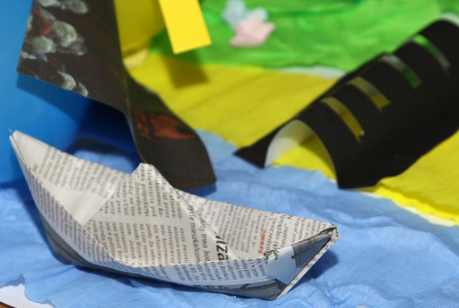
VOCATIONAL COUNSELLING AREA
Trainings/ workshops
Social /psychological skills training
Skills necessary to find a job
Specialized seminars
„Which way to work?”
Trainings conducted by companies,
Trainings conducted by Career Office staff.
Notes:
7

Slide 8

SOCIAL RESEARCH AREA
Annual reports on job offers
Graduates’ survey
Employers’ expectations towards
University of Silesia graduates
National system of monitoring
graduates’ careers
Evaluation of Career Centre activity (students’ survey)
Notes:
8

Slide 9
ACADEMIC CENTRE OF ENTREPRENEURSHIP
START – Academic Entrepreneurship
Academic Business Incubator (ABI)
Creator of Innovations
Notes:
9

Slide 10
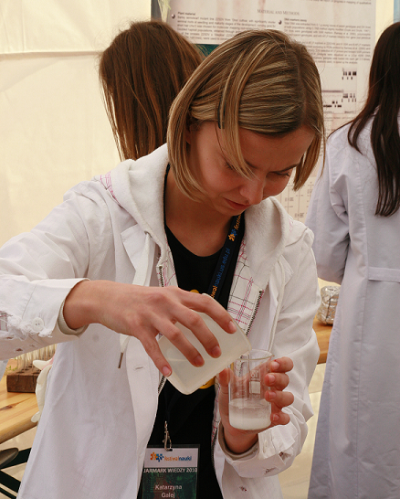
START – ACADEMIC ENTREPRENEURSHIP
Project START – Academic Entrepreneurship is financed by European Social Fund.
Project conducted in cooperation with
8 partners, including 6 major universities
of the region
Aim: to support scientists and business
in cooperation via innovations
and technology transfer
Beneficiaries: 300 students (1st, 2nd and
3rd stage of academic education),
academic teachers
Time frame: september 2011 –
september 2013
Activities: workshops, counselling,
academic entrepreneurship promotion
Notes:
Decision game, successful managing the innovative entreprise, improving functioning of entreprises – particularly their cooperation with universities and business support institutions, design. Counseling legal, financial, concerning marketing and promotion
10

Slide 11

ACADEMIC BUSINESS INCUBATORS
The aim of Academic Business Incubators (ABI):
Facilitation of the advancement of
entrepreneurship among
the younger generation in Poland.
Academic Business Incubators
help young individuals to enter
the world of business:
without the need to establish a private
enterprise,
reduces costs, paperwork and the risk to young entrepreneurs,
enables them to focus on the development of their own business venture.
Notes:
11

Slide 12
ACADEMIC BUSINESS INCUBATORS
Stages of registering a business within ABI:
Idea for a business
Applying to ABI
Orientation meeting
Application evaluation
Signing the agreement with ABI (for 2 years )
Training on the principles of operation within ABI
Monthly membership fee is about 55 euro.
Notes:
12

Slide 13
CREATOR OF INNOVATIONS
Project financed by Ministry of Science and Higher Education
Aim: to promote and support establishing new enterprises by students and young professionals
Time frame: December 2011 – December 2013
Beneficiaries: 300 students and graduates (also PhD students and academic teachers) leading to establish10 new enterprises
Activities: workshops, accountant support, intellectual property
counselling, legal support
Notes:
13

Slide 14
GO TO WORK!
Project financed by Lifelong Learning Programme
Aim: to enable vocational experience and achieving practical competences in the field of knowledge of the beneficiaries, as a result increasing their chances to be employed, not only in Poland, but also on the European market.
Time frame: July 2011 – May 2013
Beneficiaries: young graduates of the following specializations: Mathematics, Physics, Biology, Biotechnology, Geology, Computer Science and Materials Science
Activities: organizing 24 internships in three countries: Germany, Italy and France.
Notes:
14

Slide 15
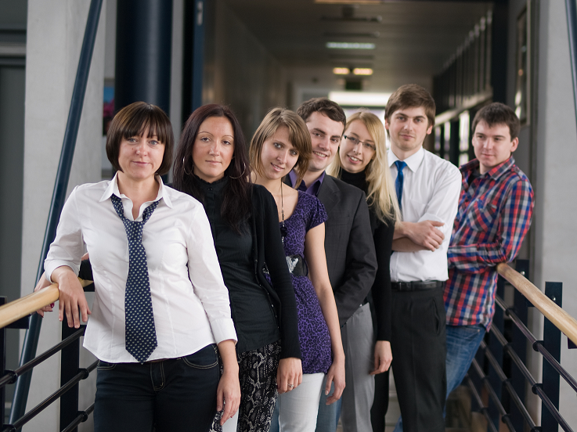
CAREER CENTRE
UNIVERSITY OF SILESIA IN KATOWICE
Thank you for your attention!
Notes:
15

