Slide 1

Student Conference of Serbian Universities (SCSU)
Miša Živić, President of SCSU
30th January 2012, Belgrade, Serbia

Slide 2



Introduction
Law on higher education (LHE) - 2005: legal framework for implementation of Bologna declaration and Lisbon convention.
Implementation of Bologna declaration process began in academic 2006/07.
Students as:
- partners in decision making process
- equal members of the academic community
Students Parliament of high education institutions – Article 56. LHE
Student Conference of Serbian Universities (SCSU) – Article 22. LHE
SCSU – Student Conference of Serbian Universities

Slide 3
Hierarchy of students representatives
Student Conference of Serbian Universities - SCSU
Student parliaments of Univresities
Student parliaments of Faculties
250.000 students
SCSU – Student Conference of Serbian Universities

Slide 4
SCSU – General
Highest students representative body in Serbia.
55 student delegates from 14 public and private Universities.
Represents 250.000 students from Serbia.
Form of Students' Parliament of Serbia.
First mandate - 15th January 2010
Second mandate – 26th November 2010
SCSU – Student Conference of Serbian Universities

Slide 5
SCSU - Position
National Assembly of Republic of Serbia
Ministry of Education
Commission for Accreditation and quality control
National Council for Higher Education
Student Conference of Serbian Universities
Conference of academies
for applied studies
Student Conference of Academies for applied studies
Conference of Serbian Universities
Institutions of higher education
SCSU – Student Conference of Serbian Universities

Slide 6
SCSU - Organizational structure
Board
President
Students standard
International cooperation
Reform of high education
Cooperation with economy
Ecology
Science
Sport
Parliament
of SCSU
President council
SCSU – Student Conference of Serbian Universities

Slide 7
SCSU - Ingerentions
Jurisdictions:
Represents and supports the rights and interests of all Serbian University students.
Represents Serbian students at the international level.
Coordinates work of all Students' parliaments in Serbia.
Supports and initiates student projects and policy developments in higher education.
Delegate representatives in:
National Council for Higher Education.
Commission for Accreditation and quality control.
Students' standard institutions (Students' center, campuses, resorts, etc.).
Working groups in jurisdiction of Ministry of education.
European Students' Union (ESU) – in process.
SCSU – Student Conference of Serbian Universities

Slide 8

Forum of students and businessmen
of Serbia 2011
SCSU – Student Conference of Serbian Universities

Slide 9
Forum of students and businessmen of Serbia 2011
Forum was international student’s project organized by SCSU from 06 – 08.12.2011. in Belgrade, Serbia.
The goal of this project was initiating the changes in plans and programmes of institutions of higher education in Serbia in order to align students’ knowledge with the market needs.
Panel discusion with president of Serbia, ministry of education and science, and CEO’s from two big companies.
15 round tables was organized on the topics of competencies, knowledge and skills which one student needs in order to find a job.
Lectures and workshops for students was organized with topics related to projects, concerning cooperation with the industrial sector and decreasing the percentage of unemployment.
Forum was very important link for connecting students with the economy sector, youth offices and career development centers.
SCSU – Student Conference of Serbian Universities

Slide 10
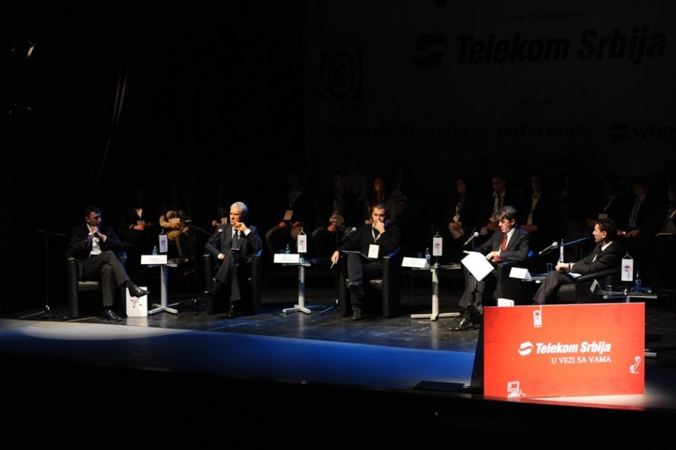
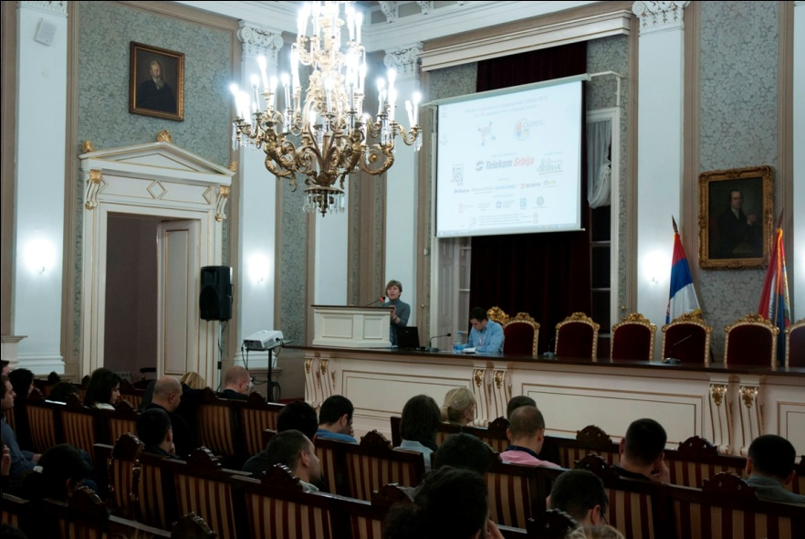
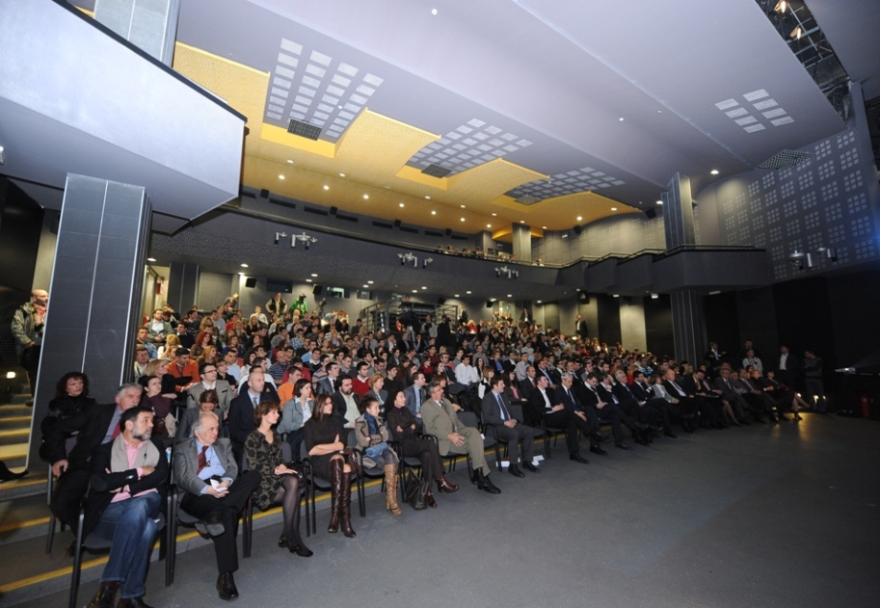
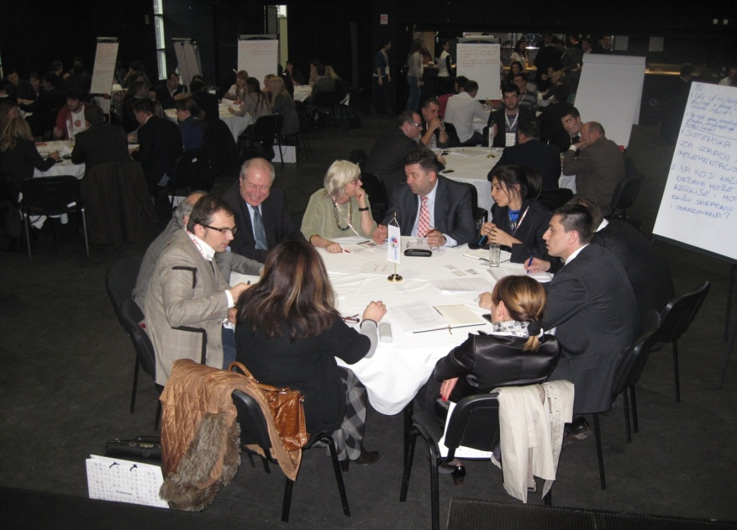
Forum of students and businessmen of Serbia 2011
150 students at workshops, 15 round tables with 120 participants (43 companies)

Slide 11
Conclusion
Students' role in decision making process and reform of higher education – ESSENTIAL!
Unity
Initiative
Competence
SCSU – Student Conference of Serbian Universities

