Slide 1


UNIVERSITY OF BELGRADE
University Centre for Career Development and Student Counselling
www.razvojkarijere.bg.ac.rs
Studentski trg 1, Beograd
+381 11 3207 419
centar@razvojkarijere.bg.ac.rs

Slide 2

UNIVERSITY OF BELGRADE, University Centre for Career Development and Student Counselling

Slide 3
Group counselling – topics:
- Writing CV and motivation letter (95%)
- Career planning (5%)
UNIVERSITY OF BELGRADE, University Centre for Career Development and Student Counselling

Slide 4
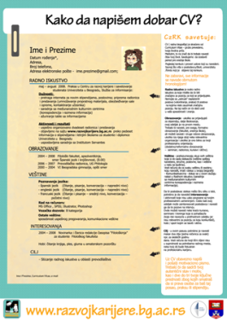
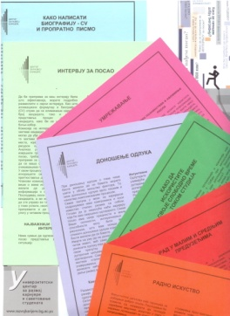
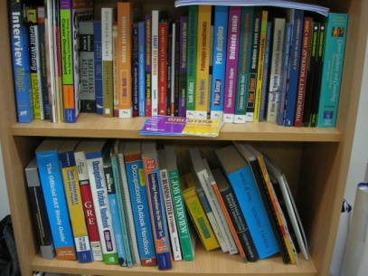
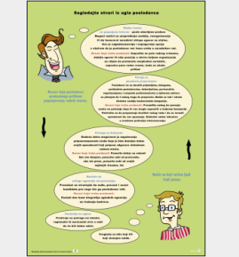


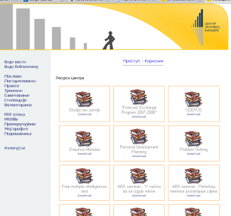
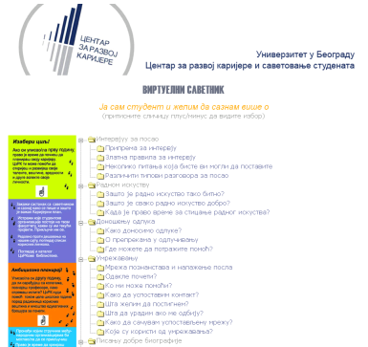
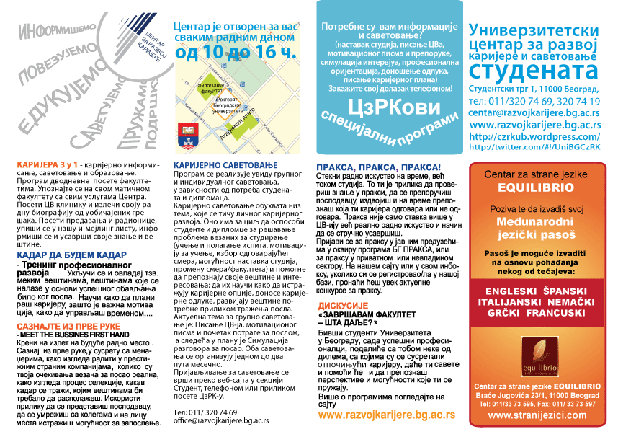
CAREER EDUCATION
Lectures and workshops
Take-away publications
(edu-brochures, booklets , posters)
Library and resource area
On-line resources
UNIVERSITY OF BELGRADE, University Centre for Career Development and Student Counselling

Slide 5
Cooperation with the business world / by sectors
UNIVERSITY OF BELGRADE, University Centre for Career Development and Student Counselling

Slide 6
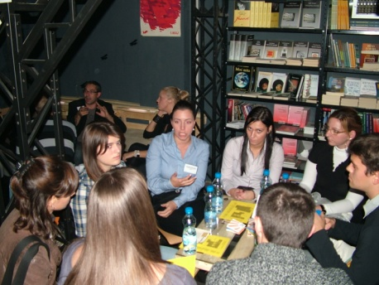
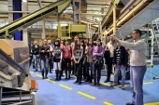
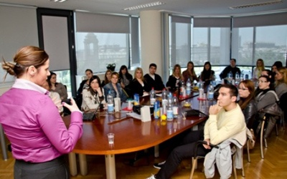
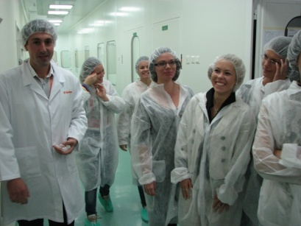
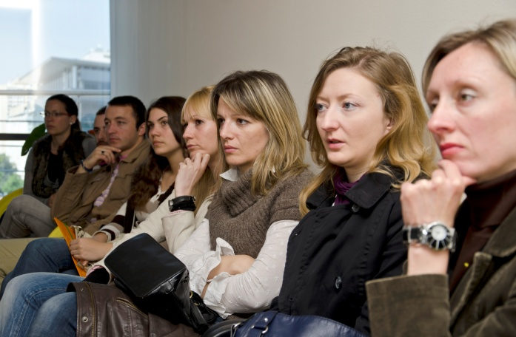
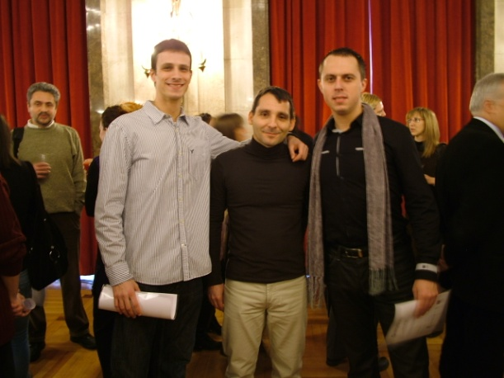
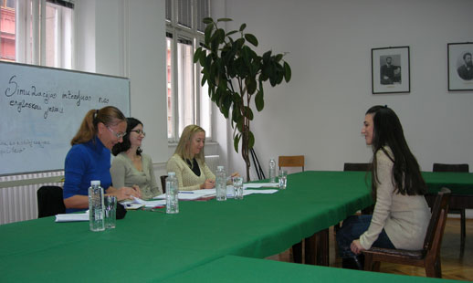
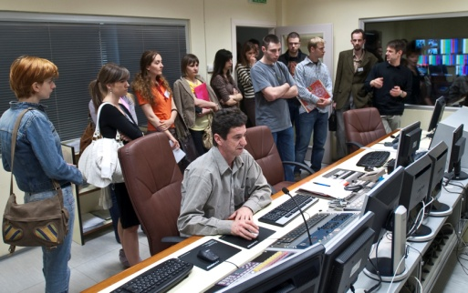
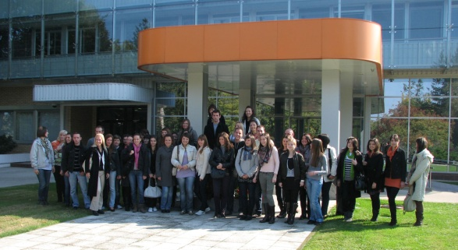
Cooperation with the business world – programs
UNIVERSITY OF BELGRADE, University Centre for Career Development and Student Counselling

