Slide 1

University Centre for Career Development
and Student Counseling
University of Kragujevac
www.razvojkarijere.kg.ac.rs
razvojkarijere@kg.ac.rs

Slide 2
What is Centre ?
University Centre for Career Development and Student Counseling is an organizational unit of the University of Kragujevac whose main goal is to prepare students for the labor market, to connect them with employers and to provide support for them in acquiring skills and knowledge needed in modern business society.

Slide 3
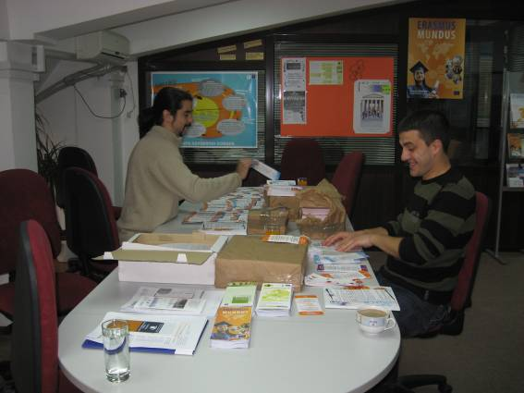

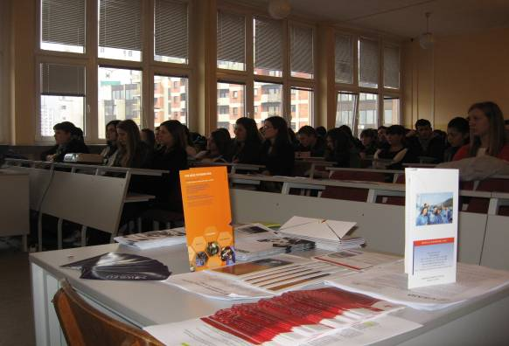

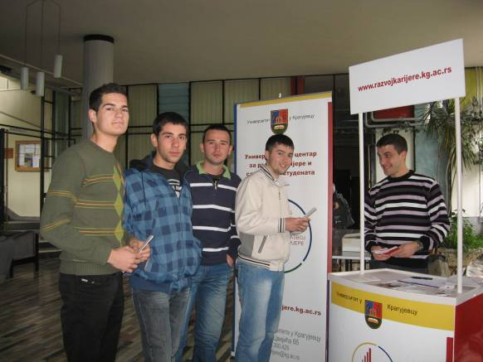
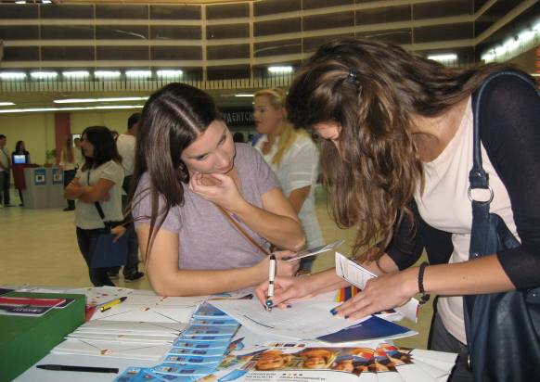

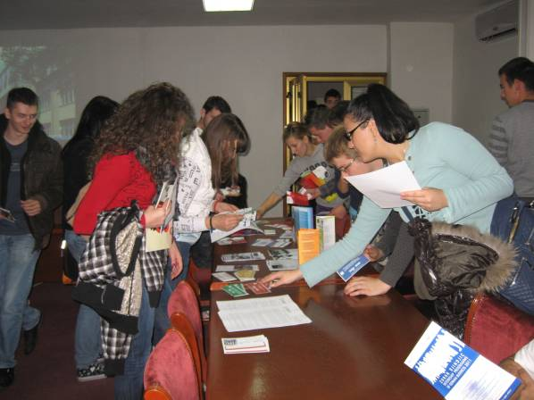
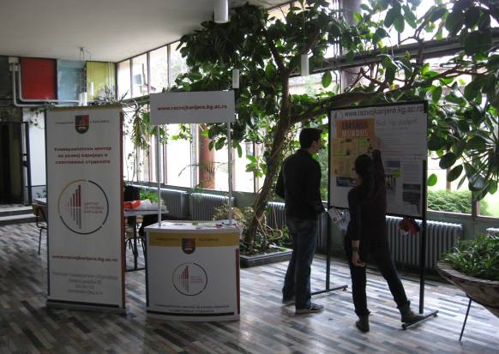

INFORMING

Slide 4
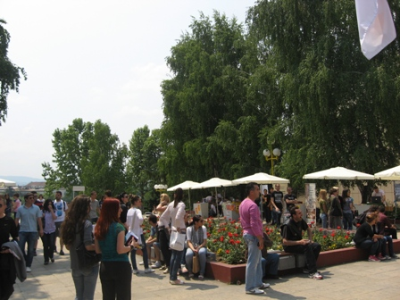
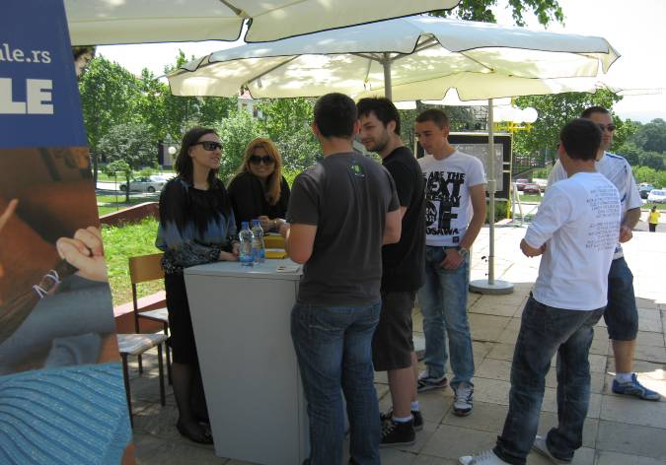
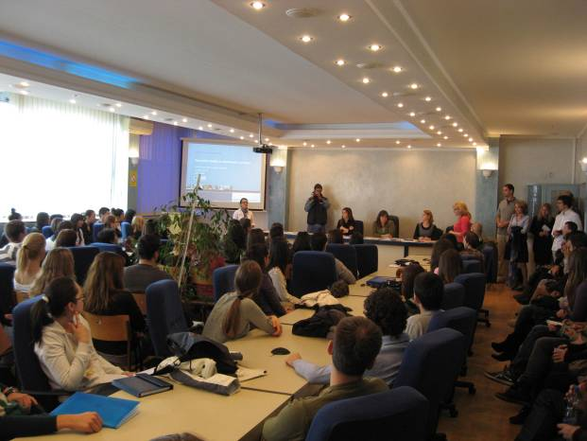
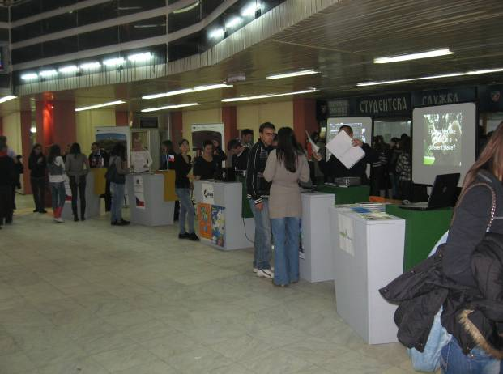
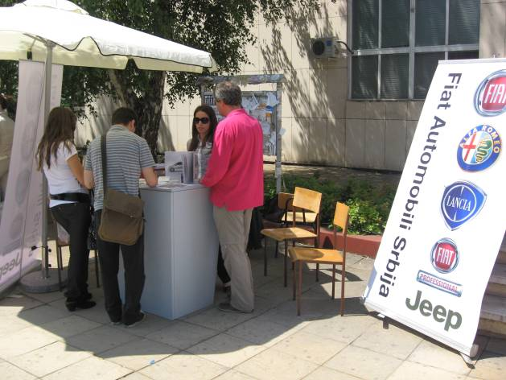
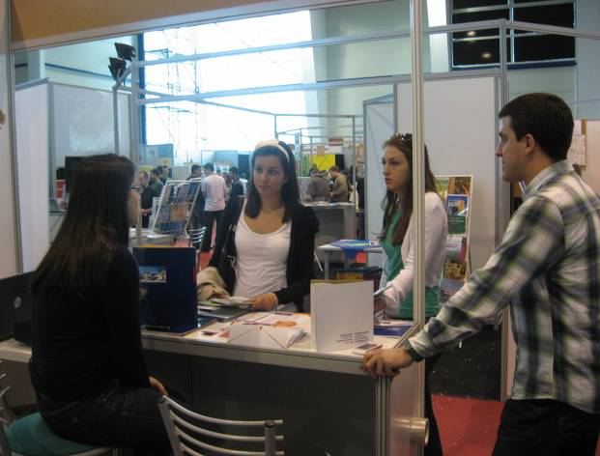
PRESENTATIONS AND FAIRS
Presentations of foundations and organizations
Scholarship Fairs
Student Days Manifestation
Centre on other Fairs
Presentations of companies

Slide 5
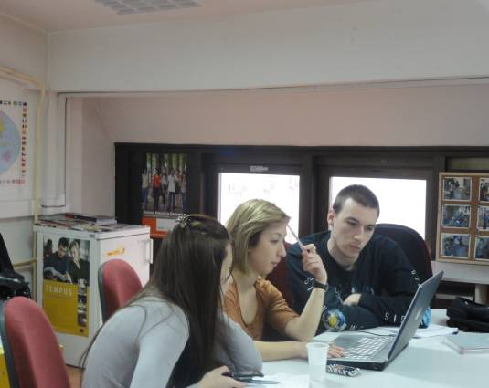
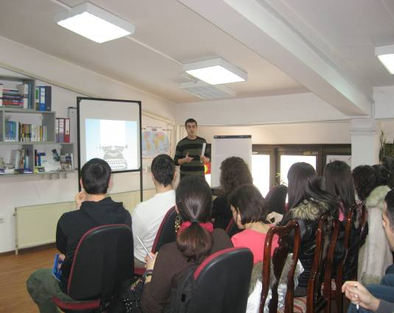
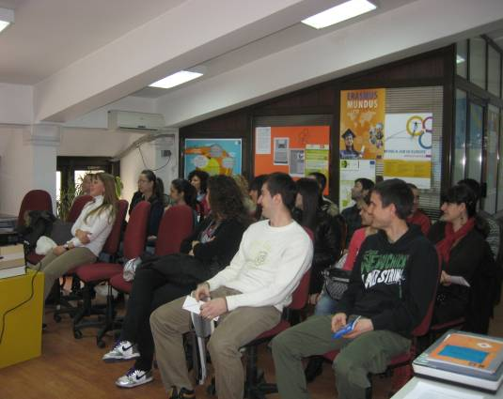
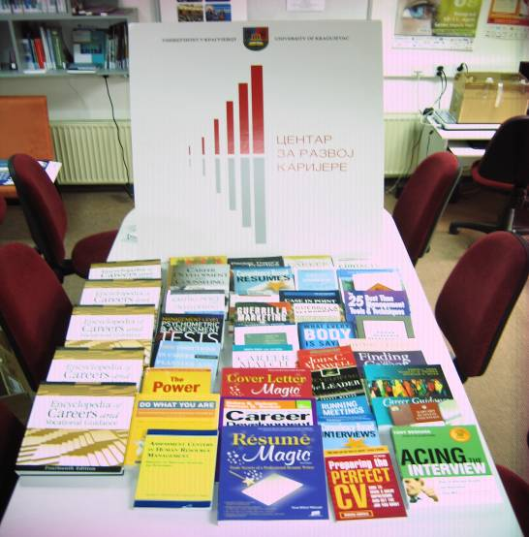
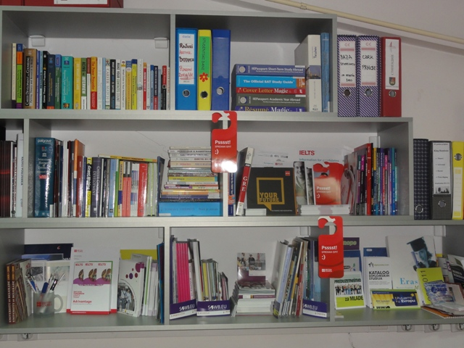
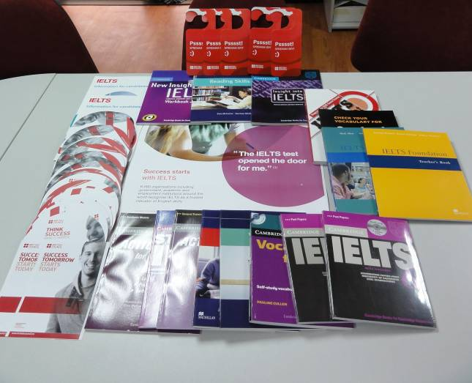
WORKSHOPS, COUNCELING AND CENTRE’S RESOURCES

Slide 6
THANK YOU
FOR YOUR ATTENTION!

