Slide 1


Initial meeting on the Careers project’s Work Package 6
  CAREER GUIDANCE
  AT UNIVERSITIES
  IN SERBIA
Notes:
1

Slide 2
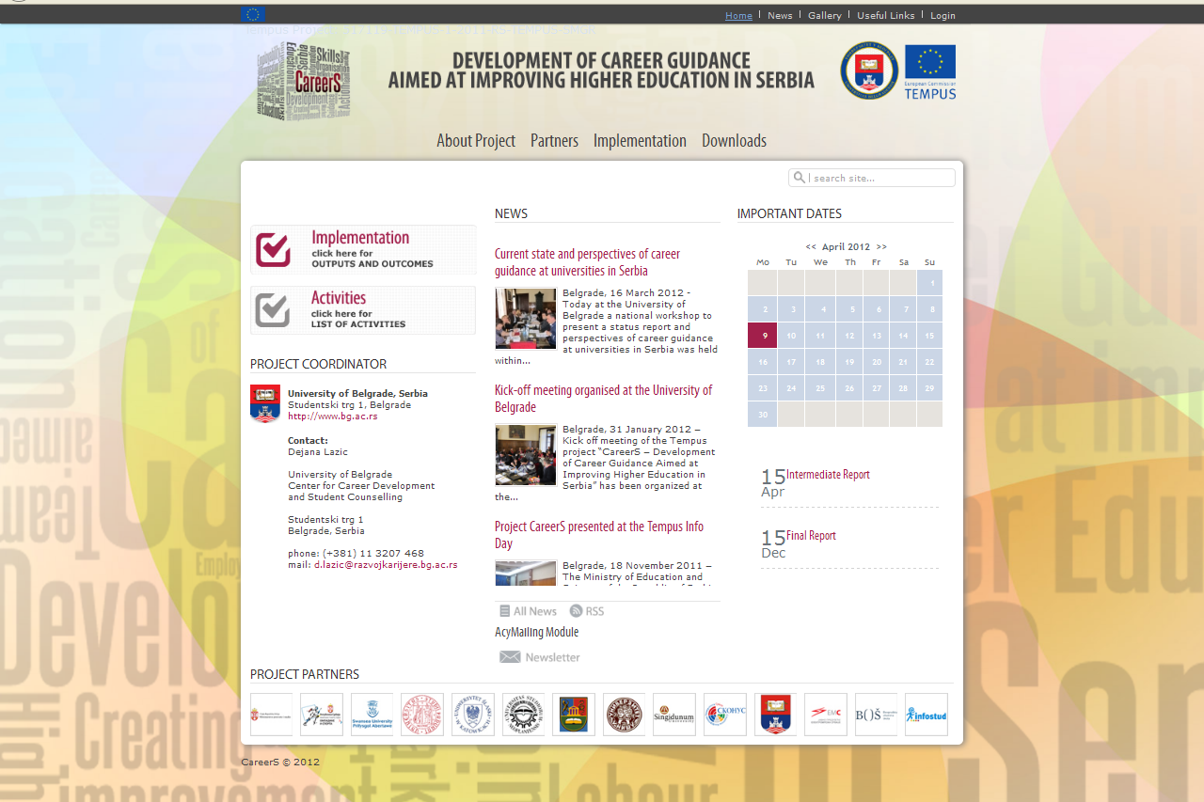
A publication on career guidance at universities in Serbia
is made available on-line at the website of the CareerS project
www.careers.ac.rs

Slide 3
On Publication
This publication aims at offering the review of objectives, activities, programs and achievements of career development centres in universities in Serbia, as well as at offering some answers to the following questions:
What are the perspectives of career guidance development in university education?
When and why were university centers for career development established in Serbia?
What services do they offer to students? What do they have in common, and in what do they differ? ...

Slide 4
University Centre for Career Development and Student Counselling of the University of Belgrade
The Centre assists students of Belgrade University in the development of relevant knowledge and skills for their employment;
it helps them in their acquisition of work experience during studies and knowledge of the world of business, and
prepares students for a successful transition to the next level of career development after graduation.
Objectives:
1. Ensuring an effective system of support to students and graduates in their development of knowledge and skills which they will need for employment or continuation of education.
2. Increase of percent of students and graduates who have acquired a relevant work experience during studying and soon after graduation.
3. Ensuring cooperation with all faculties of Belgrade University and enhancing integration role of Belgrade University.
4. Promotion of students and graduates of Belgrade University as future experts in different spheres of work and the University of Belgrade as a leading institution for university education in the region.

Slide 5
University Centre for Career Development and Student Counselling of University of Novi Sad
The University Centre is an organizational unit of the University of Novi Sad established to ensure an effective system of support to undergraduate and graduate students in developing their knowledge and skills which they will find significant for employment or further education and for liaison between the academic and business community.
The activities of the University Centre include:
• developing competencies, knowledge and skills of students which are crucial for their employment;
• provision of information to students on opportunities for additional education, scholarships in the country and abroad, and job offers;
• ensuring liaison of students and employers by organizing vocational practice and training programs in leading companies and organizations in the country for potential employment;
• organizing presentations on companies, their business ethics and recruitment policies;
• consultancy to students having dilemma with respect to choosing career or positioning at the labour market after graduation;
• other counselling services with respect to career development;
• coordination of work of career development centres at the faculties within the University;
• monitoring of accomplishment of strategic objectives in the sphere of employment in cooperation with the Committee for Strategic Development within the University Council.

Slide 6
University Centre for Career Development and Counselling of Students of University of Niš
The University Centre:
1. monitors and analyses student enrolment rates and efficiency of studying;
2. identifies problems in execution of curriculum and submits reports thereof to the Council of the Centre;
3. drafts competition advertisement for enrolment of students in the first year of studies and timely submits it to competent authorities;
4. ensures timely publishing of the student enrolment competition;
5. prepares information publications, internet presentations and other ways of introducing potential students to study opportunities in the University;
6. makes contacts with competent employment services, collects and publishes information on student employment potentials;
7. makes an integral database on graduate University students employed locally and internationally;
8. collects and publishes information on student scholarships and funding potentials;
9. organizes meetings of potential employers with students;
Notes:
The Centre for Career Development in Niš offers free services to students, making the emphasis on the execution of vocational practice, development of significant capabilities such as writing professional resumes, job seeking and preparation of students for an interview with potential employers. The centre supports the activities aiming at improving liaison between academic communities, organizing visits of international experts for sharing experience and knowledge and creation of network of students, teachers, potential employers and other subjects that might contribute to the development of individual knowledge and skills.

Slide 7
University Centre for Career Development and Counselling of Students of University of Kragujevac
The activities of the University Centre include:
• developing competencies, knowledge and skills of students which are crucial for their employment;
• provision of information to students on opportunities for additional education, scholarships in the country and abroad, and job offers;
• ensuring liaison of students and employers by organizing vocational practice and training programs in leading companies and organizations in the country for potential employment;
• organizing presentations on companies, their business ethics and recruitment policies;
• consultancy to students having dilemma with respect to choosing career or positioning at the labour market after graduation;
• other counselling services with respect to career development;
• coordination of work of career development centres at the faculties within the University;
• monitoring of accomplishment of strategic objectives in the sphere of employment in cooperation with the Committee for Strategic Development within the University Council.

Slide 8
University Centre for Career Development and Counselling of Students of Singidunum University and FEFA Career Centre
A career development centre is the starting point for personal career development of Singidunum University students and a permanent base for career guidance during work life cycle. The Centre conducts the following activities: career information, guidance and counselling of students; organization of educational events; liaison of students with industry; international cooperation; work on projects; cooperation with student organizations
Objectives:
1. Training students to manage their own career results in their acquisition of basic skills assisting them in starting their own business or finding a job that is suitable to their qualifications and presenting them in the best light so that they could become employed.
2. Professional assistance to employers in human resources management includes the provision of professional services such as selection, further education, job descriptions, code of conducts, business ethics, company values, etc.
3. Support to the University in managing quality based on monitoring students‘ careers provides suggestions for changing educational contents and improvement of the existing ones in order to maintain the University as the place of top quality knowledge and expertise.
4. Completing database with updated information on students and employers. The database is used for presenting students and employers in order to facilitate their direct contact and establish cooperation.

Slide 9
 | Numbers of students / faculties | Permanently employed staff / other staff in Career Services | Monthly average of interactions with students | Monthly average number of website visits
University of Belgrade | 89000 / 31 | 4/2 | 200 – 250 | 15000-20000
University of Novi Sad | 45000 / 14 | 1/10-15 | Up to 50 | No data
University of Niš | 28660 / 13 | 1/2 | 50 – 100 | Up to 5000
University of Kragujevac | 17000 / 12 | 0/2 | 50 – 100 | Up to 5000
Singidunum University | 12000 / 9 | 5/5 | More than 250 | Up to 5000

Slide 10
REGULAR ELEMENTS IN WORK OF CAREER CENTRES
5-Regularly, 4-often, 3-sometimes, 2-rarely, 1-never
 | UBG | UNS | UNI | UKG | USG
Center investigates, monitors and analyzes the needs of students | 5 | 3 | 4 | 3 | 5
Center informs students about opportunities for career development | 5 | 4 | 4 | 3 | 5
Center creates a variety of educational materials for students | 5 | 3 | 3 | 3 | 4
The Center offers individual counseling and student support | 5 | 3 | 4 | 5 | 5
The Center organizes and conducts educational activities | 5 | 3 | 3 | 5 | 5
Center includes academic staff in their programs | 3 | 2 | 4 | 3 | 5
Center includes representatives from the business community in their programs | 5 | 3 | 4 | 2 | 5
Center includes representatives of the students / volunteers in their programs | 5 | 4 | 4 | 3 | 5
Center distributes information through the management of the Faculty | 5 | 3 | 4 | 4 | 3
The Centre conducts evaluation of its programs | 5 | 4 | 3 | 5 | 4
Center to participate in fairs | 5 | 3 | 3 | 5 | 5
The Center organizes fairs at the University | 5 | 1 | 3 | 5 | 2
The Centre provides support to graduates a certain time after graduation | 5 | 4 | 3 | 5 | 5
The center is engaged in attracting prospective students | 2 | 1 | 4 | 3 | 5
Notes:
These elements are not supposed to give whole picture of

Slide 11
IMPORTANCE OF ELEMENTS IN WORK OF CAREER CENTRES
1 – not important, 2 – little important, 3 – it is and it isn’t important, 4- important, 5 – very important
 | UBG | UNS | UNI | UKG | USG
Center investigates, monitors and analyzes the needs of students | 5 | 5 | 5 | 5 | 5
Center informs students about opportunities for career development | 5 | 5 | 5 | 5 | 5
Center creates a variety of educational materials for students | 5 | 4 | 5 | 5 | 5
The Center offers individual counseling and student support | 5 | 3 | 5 | 5 | 5
The Center organizes and conducts educational activities | 5 | 4 | 4 | 5 | 5
Center includes academic staff in their programs | 5 | 4 | 4 | 5 | 4
Center includes representatives from the business community in their program | 5 | 5 | 5 | 5 | 5
Center includes representatives of the students / volunteers in their programs | 5 | 4 | 5 | 5 | 5
Center distributes information through the management of the Faculty | 5 | 3 | 4 | 5 | 5
The Centre conducts evaluation of its programs | 5 | 4 | 5 | 5 | 5
Center to participate in fairs | 4 | 4 | 5 | 5 | 5
The Center organizes fairs at the University | 5 | 4 | 4 | 5 | 3
The Centre provides support to graduates a certain time after graduation | 5 | 4 | 3 | 5 | 5
The center is engaged in attracting prospective students | 5 | 3 | 5 | 4 | 5

Slide 12
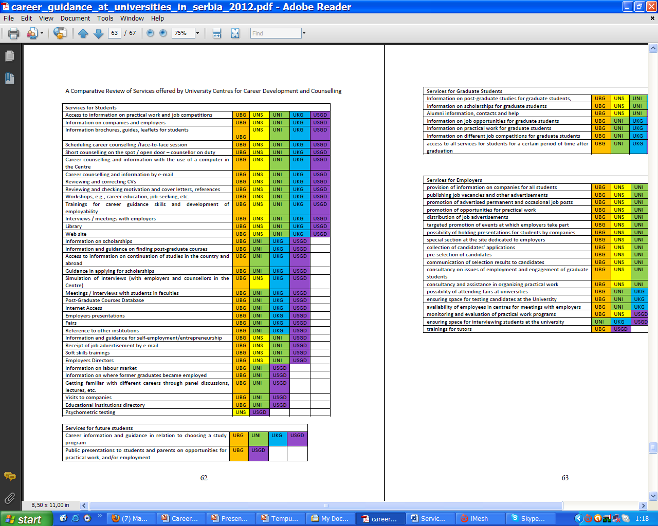
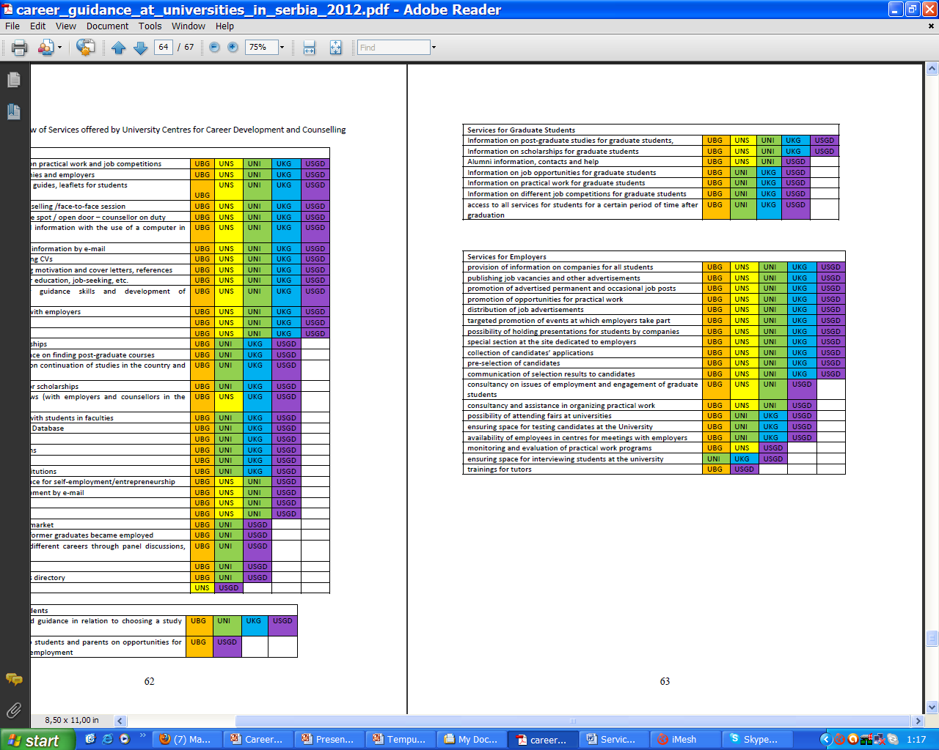

Slide 13


University of Belgrade
Centre for Career Development and Student Counselling
Studentski trg 1, Belgrade, Serbia
www.razvojkarijere.bg.ac.rs
centar@razvokarijere.bg.ac.rs
Notes:
13

