Slide 1

Career Service Centre
University of Silesia in Katowice
cooperation with the stakeholders:
experiences and good practices

Slide 2

A few facts about University of Silesia

Slide 3

the largest university in the region
one of the largest in Poland
present in four silesian cities
12 faculties
42 programmes and 115 specializations
40 000 students

Slide 4
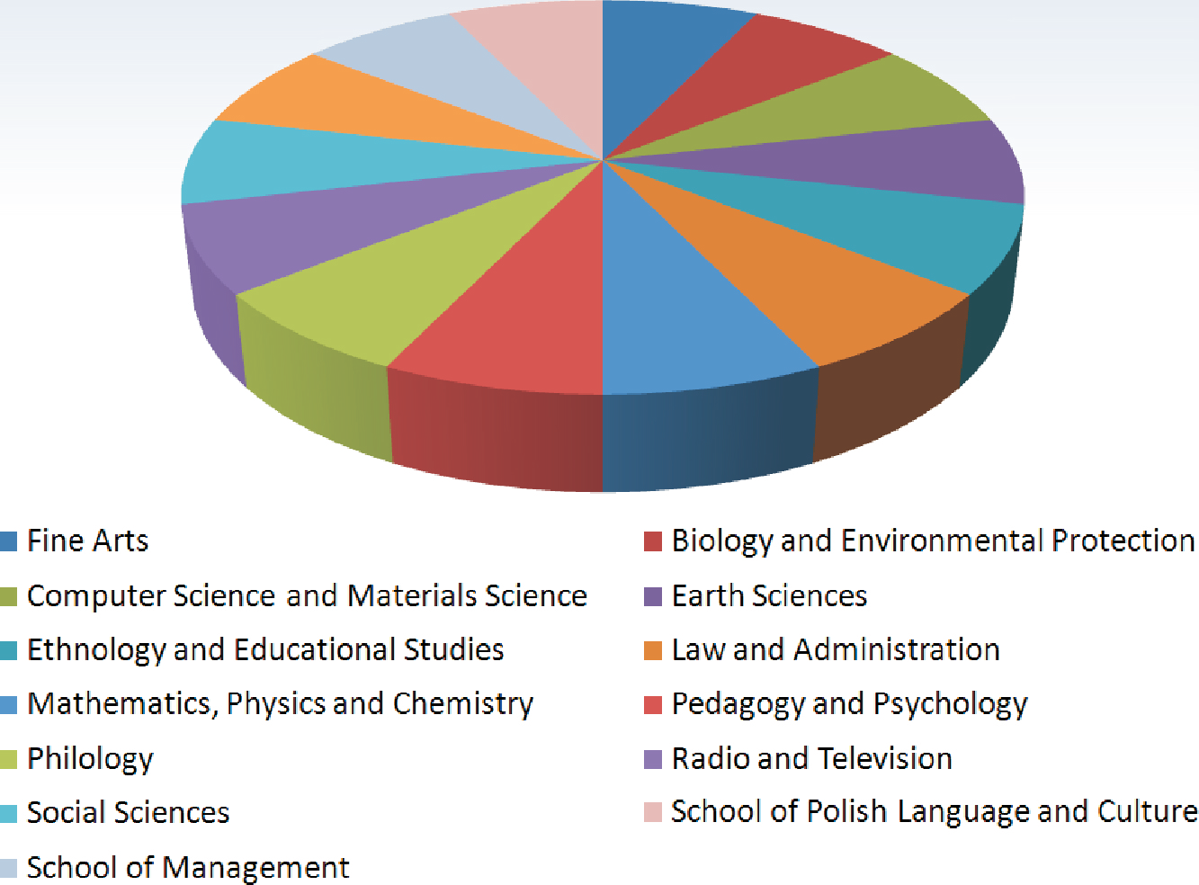

Slide 5
What shapes higher education in Poland?

Slide 6
The Bologna process – designed to introduce a system of academic degrees that are easily recognisable and comparable, promote the mobility of students, teachers and researchers, ensure high quality teaching and incorporate the European dimension into higher education.
Promoting employability – stakeholders should cooperate to raise initial qualifications and renew a skilled workforce, as well as to improve the provision, accessibility and quality of guidance on careers and employment. In addition, work placements included in study programmes and on-the-job learning should be further encouraged

Slide 7
European Qualifications Framework (EQF)
its aim is to enable everyone interested to understand and compare national education and training systems. It is also a trigger to such rebuilding programmes to better suit economy’s needs.

Slide 8
Strategy „Europe 2020” is considered to be European Union answer to the crisis. One of its main statements is to create a programme for new skills and employment.
It aims at incerasing the number of people aged 20-64 employment to 75%.
Notes:
Inicjatywa nie spoczywa li tylko na uczelniach. Istotną rolę w kształtowaniu dobrych wzorców może odgrywać Ministerstwo. Zamawiane kierunków nie jest jedynym dostępnym narzędziem. Podjęcie wątku monitorowania losów zawodowych absolwentów był dobrą próbą, zabrakło jednak Ministerstwa w roli gospodarza, stąd do dziś brakuje wyraźnych pomysłów na wykorzystanie wyników dla celów poprawy jakości kształcenia (dane nie są jednoznaczne, dotyczą złożonego systemu zależności pomiędzy stanem prawnym, popytem na studia i otoczeniem gospodarczym), nie mówiąc już że brak podstawowych definicji, np. sukcesu zawodowego absolwenta.

Slide 9
This means …
Notes:
Ostatni konwent na UŚ odbył się 11 października br. W jego skład weszli:
- Śląski Kurator Oświaty (Stanisław Faber)
przedstawiciele władz samorządowych i wojewódzkich
przewodniczący sejmiku śląskiego, Marszałek, Wojewoda, dyr. WUP
przedstawiciele świata biznesu i instytucji: m.in. Tauron, ING, Węglokoks, Grupa Lotos, GTL, IBM, Katowicki Holding Węglowy

Slide 10
- tight cooperation with employers to know their needs (surveys)
- consulting the education programmes
- more practical aspects of study programmes (partly carried out by companies and practitioners)
- technology and innovation transfer to the market
- ordering diploma papers
Notes:
W UŚ funkcjonuje AIP, którego koordynatorem jest BK. To jednak nie jedyny sposób na wspieranie przedsiębiorczości akademickiej praktykowany na UŚ. To także szkolenia, spotkania z pracodawcami, projektu doradcze i networkingowe.

Slide 11
How does career centre work?
Notes:
Obszar ten wymaga największej uwagi. Co prawda na UŚ mamy przykłady takiej współpracy, jednak jest ona słabo rozwinięta. Wiąże się to głównie z brakiem zainteresowania/zapotrzebowania ze strony przedstawicieli gospodarki. Nie każda firmy bowiem ma potrzebę bezpośredniego udziału w procesie nauczania i nie każda byłaby w stanie ją zrealizować (zaplecze merytoryczne). Na pewno jest to dobry sposób na kształcenie kadr „na zamówienie”, ale również jest narzędziem CSR. Można przypuszczać, że rola takiej formy współpracy będzie wzrastać.

Slide 12
Career Service Centres are based on:
- an act issued by the Ministry of Work and Social Policy
- acts issued by rector

Slide 13
What we want to do?
Actively prepare students for transition from education to labour market by equipping them with inevitable knowledge and skills

Slide 14
Job & internship offers
Service common for 5 universities in Poland
Common database of offers, students and graduates
For employers:
Possibility to indiviually place an offer
To look through cvs and to order personal and contact data of those students who interest them the most
To direct an offer to students all 5 universities using contact with the nearby career centre.
For students & graduates:
Possibility to search positions using variety of categories
Possibility to be informed about new offers adjusted to one’s needs
Possibility to create one’s own CV
Access to wide range of offers from all over the country

Slide 15
Employers presentations & job fairs
Presentations organized usually according to specific job offers or internship programmes.
Target group chosen according to the employer’s needs
Information about this particular position, characteristics of recruitment and selection process
Information about organization culture and possibilities of development
Job Fairs
Organized twice a year: spring and autumn.

Slide 16
Employers’ workshops
Its aim is to convey practical knowlegde to
students.
Maximum – 15 students/graduates
The workshop must be at least 3 hours long + 1hour for employer’s presentation
Examples: Customer Care (Capgemini),
Assessment Centre (Randstad), Agile (Agora – press publishing company), Accountacy in international turnover (PwC), How to make a useful smartphone application (Future Processing), Information in cloud (ING Services).

Slide 17
Employers’ stands
Possibility for those employers who prefer one-
to-one contact with students.
Recommended to those companies who are not very well known by students.

Slide 18
University Convention
Convention consisting of:
University authorities
Local authorities
CEO’s of the largest companies in the Silesian region
Its aim is to cooperate, i.a. in the area of employment, consulting study programmes and technology transfer

Slide 19
University Convention – realized programmes
„Young Specialist” – 3-months internship, financed by the company.
Directed to all students who finished at least 1st year of studies.
Organized according to detailed programme
2 supervisors – one from company and one from the University.
It’s aim is to enable students to gain their firs professional experience within a business project.

Slide 20
University Convention – realized programmes
„Young Manager” – 2-years internship, financed by the company.
Directed to all students who finished at least 3rd year of studies.
Organized according to detailed programme
2 supervisors – one from company and one from the University.
Its aim is to shape a student as a future employee, usually students go through several departments fulfilling various tasks.
Development Centre is organized at the finish of the programme and company decides whether to employ the student or not.

Slide 21
University Convention – realized programmes
Mentoring programme – directed only to 15 students and managers
Lasts 1 year
Carefully selected students of the last year of studies
Mentor and mentee meet every two weeks
The process is facilitated by the Career Service Centre.

Slide 22
Why career guidance in higher education
is so important?

Slide 23
Undergraduates choose their studies according to employment possibilities
Most of the students finish studies to have a successful job
Transition from education to labour market is a stressful experience
Modern economy needs well educated people with skills adjusted to the market needs

Slide 24
We all – authorities, academic and administrative staff, students’ government shape students
to be successful in the future

Slide 25
How may we cooperate within the university?

Slide 26
How may we cooperate within the university?
conveying knowledge on employment possibilities
undertaking dialog with potential employers
motivating students to set their career goals
promoting events organized for students by Career Service Centre
promoting Career Service Centre itself

Slide 27
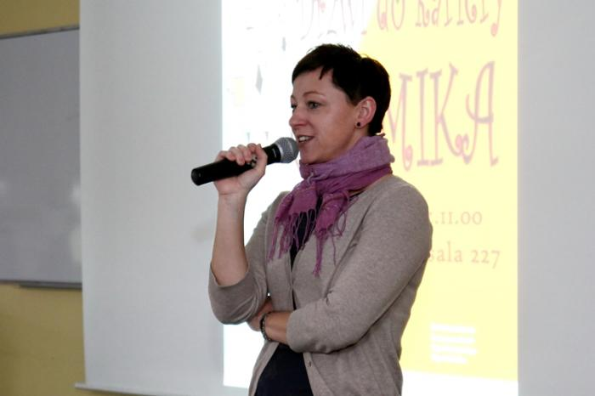
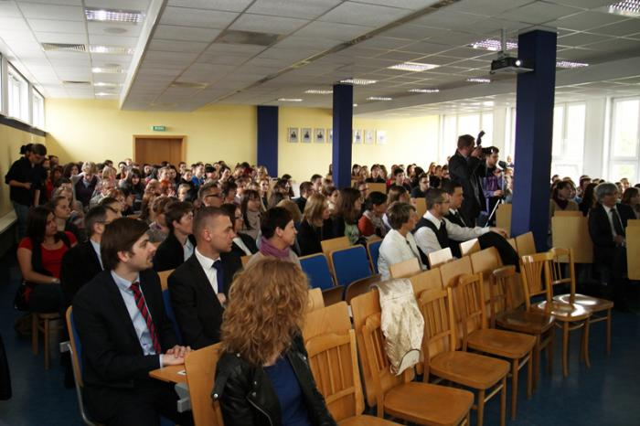
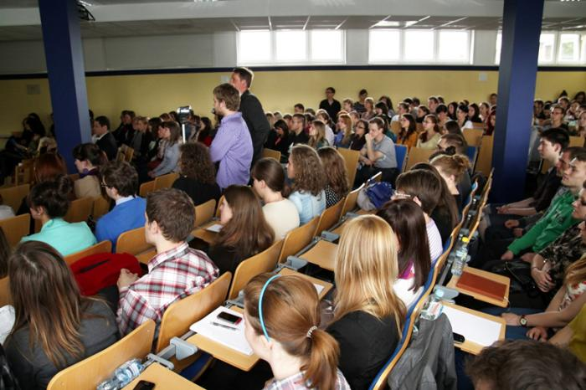
How we do it at University of Silesia?
Organizing conferences and seminars for students with potential employers
e.g. ‘The Doors to the Chemist’s Career’

Slide 28
How we do it at University of Silesia?
Organizing seminars concerning job searching skills
how to write a CV, how to prepare to the interview, how to set career goals
ordered by academic staff of particular faculties or by students’ government
workshops adjusted to the needs of particular student group

Slide 29
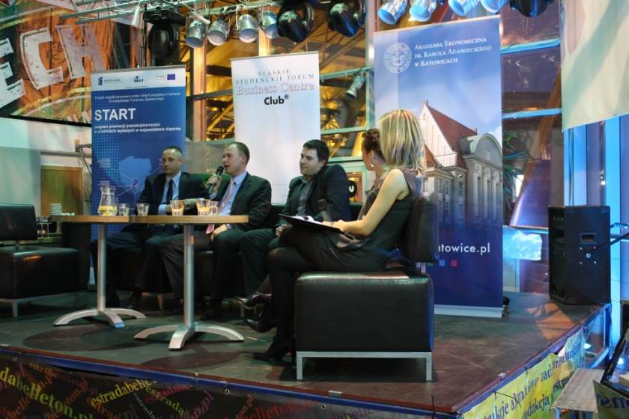
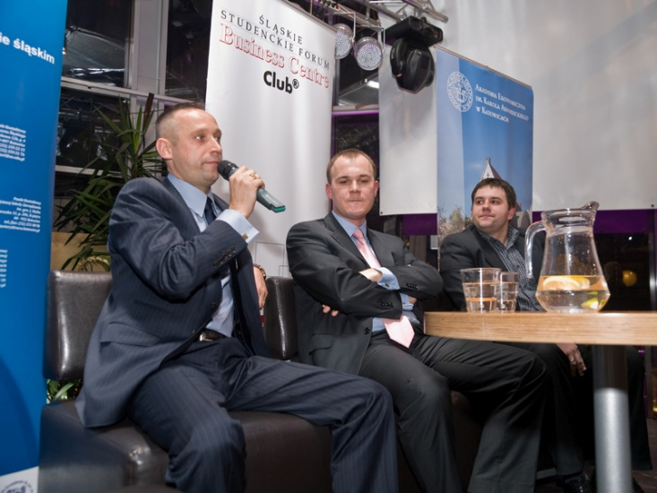
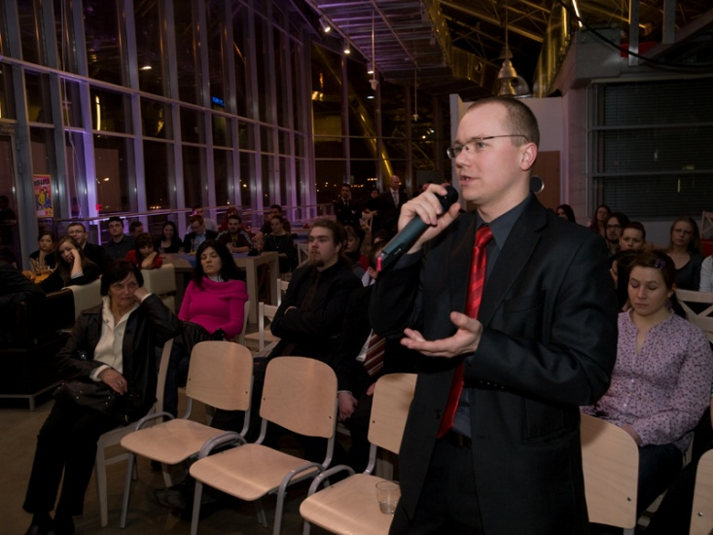
How we do it at University of Silesia?
Which way to work?
Meetings with professionals representing particular occupation in a range of interest of students (organized for students of various study programmes)

Slide 30
How we do it at University of Silesia?
Experts’ Panel
Meeting of academic staff with representatives of employers, which aim is to discuss adjustment of the study programmes to the needs of labour market

Slide 31
How we do it at University of Silesia?
Preparation to entering the labour market – programme realised at mathematics
80 hour programme for students from 2nd year onwards:
individual resources
labour market characteristics
how to apply for a job
law regulations concerning work
entrepreneurship

Slide 32
How we do it at University of Silesia?
Preparing profiled graduate survey reports on demand of faculties and other labour market analysis

Slide 33
Thank you for your attention!
Agnieszka Dunaj
agnieszka.dunaj@us.edu.pl
Barbara Smorczewska
barbara.smorczewska@us.edu.pl

