Slide 1
TEMPUS Project: Development of Career Guidance Aimed at Improving Higher Education in Serbia,
Working package 3: Cooperation with Academic Community
Belgrade, 03/03/2015

Slide 2
About the WP3
The aim of this WP is development of cooperation within academic community for greater coverage and accessibility of career information, counseling and education.
Duration: July 2012 – April 2015

Slide 3





WP3 - Partners
University of Belgrade (UB)
University of Novi Sad (UNS)
University of Kragujevac (UK)
Univestity of Niš (UN)
Singidunum University (SU)

Slide 4
Description of the activities
 | Activities
1 | Creating the plan for cooperation and the team of associates– representatives of academic staff and students for including career guidance into the work with students
2 | Design and production of CareerS kit for academic staff and students
3 | Organizing info sessions with representatives of academic staff and students
4 | Creating careers info points at the faculties within universities
5 | Organizing promotion for student population

Slide 5
1. The plan for cooperation and defined team of associates
The plan for cooperation with academic staff and student representatives and EU partners was defined by each university and approved by academic staff
Teams of associates (academic staff and student representatives) to work on including career information, counseling and education were created and meetings were organized at each university to agree on plan.
  /

Slide 6
2.Design and production of CareerS kit for academic staff and students
CareerS kit as a set of informational and educational materials (printed and online) was designed and produced
The Guidelines “Career Guidance and Counseling” for academic members, students and other stakeholders (interested in cooperation with Career Guidance (BU)
Notes:
Elekstronske stranice fakulteta i odeljka FEFA Karijera
(http://www.fefa.edu.rs/index.php?option=com_content&view=category&layout=bl
og&id=87&Itemid=556&lang=sr) i odeljka Događaji
(http://www.fefa.edu.rs/index.php?option=com_content&view=category&layou
t=blog&id=79&Itemid=23&lang=sr)

Slide 7
3. Info sessions with representatives of academic staff and students
Presentation of good cooperation with academic community (University of Silesia, University of Padova…)
Presentation of the Career Center Guidance and its services to all students
Organized lectures and workshops for professors and teachers to increase their interest about the Career Center Guidance
Workshops in Business communication for students
Meetings with academic staff and students
Individual tutorials with students on daily base

Slide 8
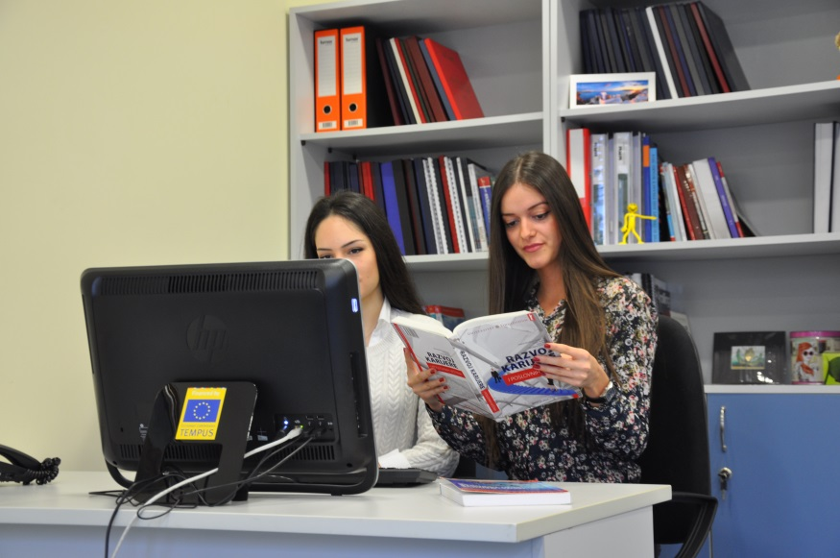
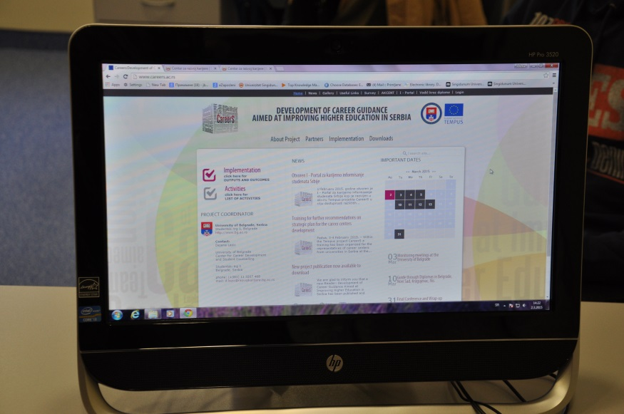
4. Careers info points at the faculties within universities
Small info points
Regular supply of materials for info points
Bulletin boards with relevant information

Slide 9
5. Promotion for student population
Promotion of the Career Centre services for students, mobility programs and internship programs (the official website of the Centre , official profile on the social networks Facebook and LinkedIn , direct e-mails to students , bulletin boards, universities , as well as telephone and direct provision of information during a visit to the Centre)
Presentation of the institutions and foundations that offer programs for student mobility, internship, scholarship
Guest lectures, educational programms, presentation and workshops for students
….

Slide 10
Public forums, events, student manifestatitons, scholarship fair, tourist tours, language and computer course
Training for the proper job search, career guidance in the selection and preparation of all documents necessary for job application, scholarships , projects , internships and more.
Promoting through a series of articles that have been published on the website of the Centre for Career Development, Facebook pofile (Daily information; Weekly Newsletter

Slide 11
To do List
Act 3.5 & 3.6 report

Slide 12
Thank you!

